Slide 1
CHRONIC HYPERTENSION
Donna D. Johnson, MD
Project ECHO South Carolina Pregnancy Wellness
December 2, 2020

Slide 2
CHRONIC HYPERTENSION
Normal: <120 and <80
Elevated BP: 120-129 and <80
Stage 1: 130-139 or 80-89
Stage 2: 140 or 90
Treatment: Stage 1

Slide 3
CHRONIC HYPERTENSION
Primary (essential):
90%
Secondary:
Medications
Illicit drugs
Pheochromocytoma
Primary aldosteronism
Cushing’s Disease
Hyperthyroidism

Slide 4
SECONDARY HYPERTENSION
Unusual presentation
Drug-resistant hypertension
Clinical clues: abdominal bruit, low potassium

Slide 5
CHRONIC HYPERTENSION IN PREGNANCY
HTN prior to conception or <20 weeks
>140/90
2 times
4 hours apart
Severe range BP: >160/110

Slide 6
TREATMENT IN PREGNANCY
>160/110
CHIPS
Diastolic < 85 vs. <100: no benefit to fetus
Less severe maternal hypertension
Earlier treatment: organ damage

Slide 7
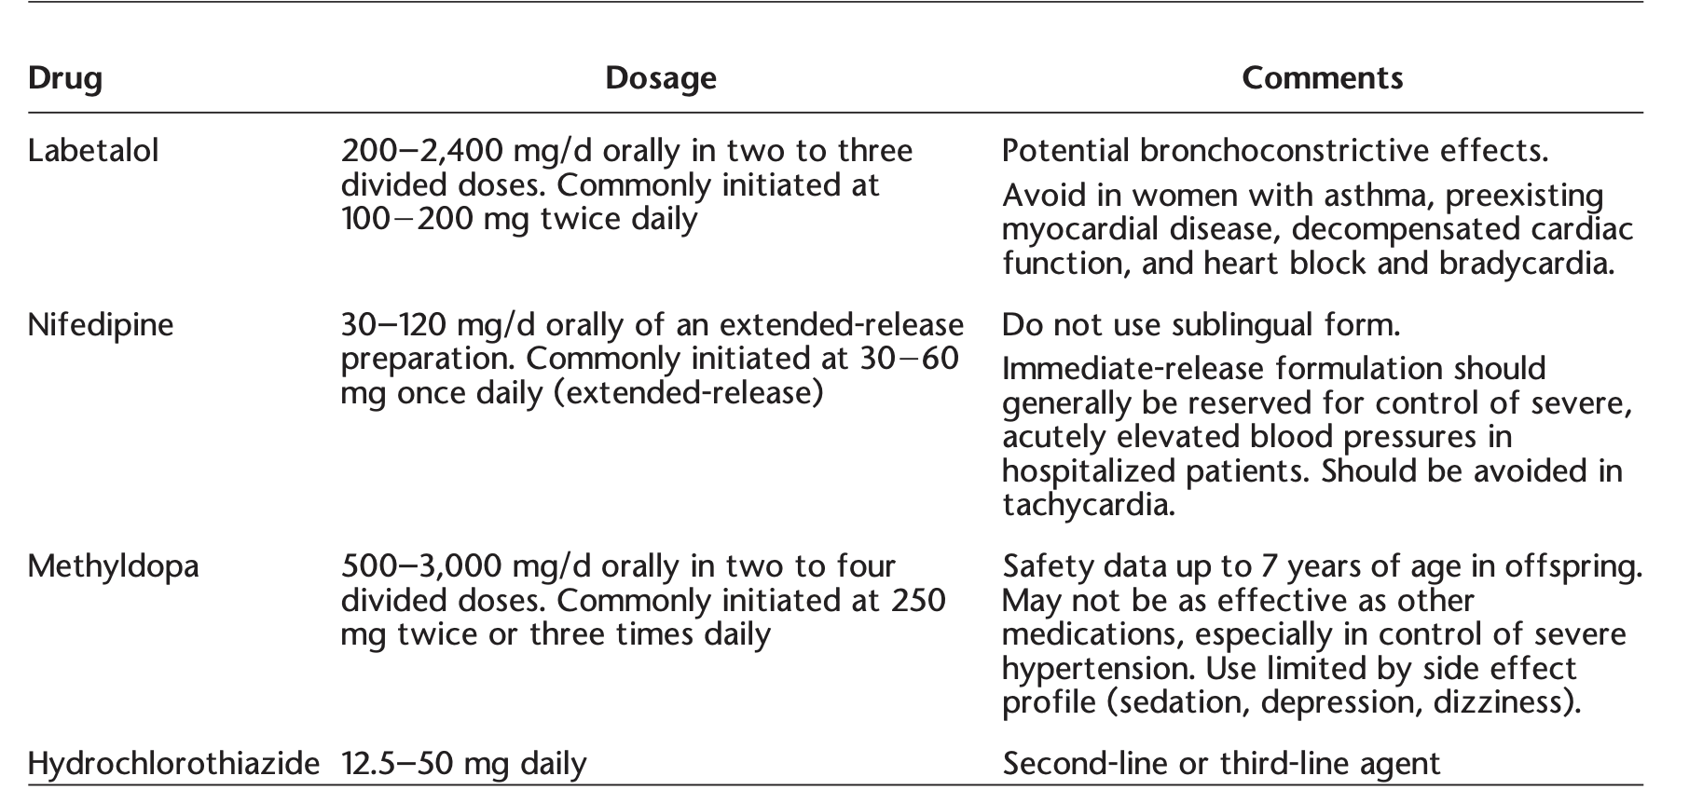
MEDICATION

Slide 8
ACE INHIBITORS/ARB
Fetal heart & CNS: controversial
Renal: second & third trimester

Slide 9
ATENOLOL
Avoid
IUGR

Slide 10
LABS
P:C ratio
Creatinine
EKG or ECHO: longstanding HTN

