Slide 1
Divya Ahuja, MD, MRCP (London)
Prisma – University of South Carolina

Slide 2
NIH Treatment guidelines
The therapeutic management of pregnant patients with COVID-19 should be the same as for nonpregnant patients
The COVID-19 Treatment Guidelines Panel recommends against withholding treatment for COVID-19 and SARS-CoV-2 vaccination from pregnant or lactating individuals because of theoretical safety concerns

Slide 3
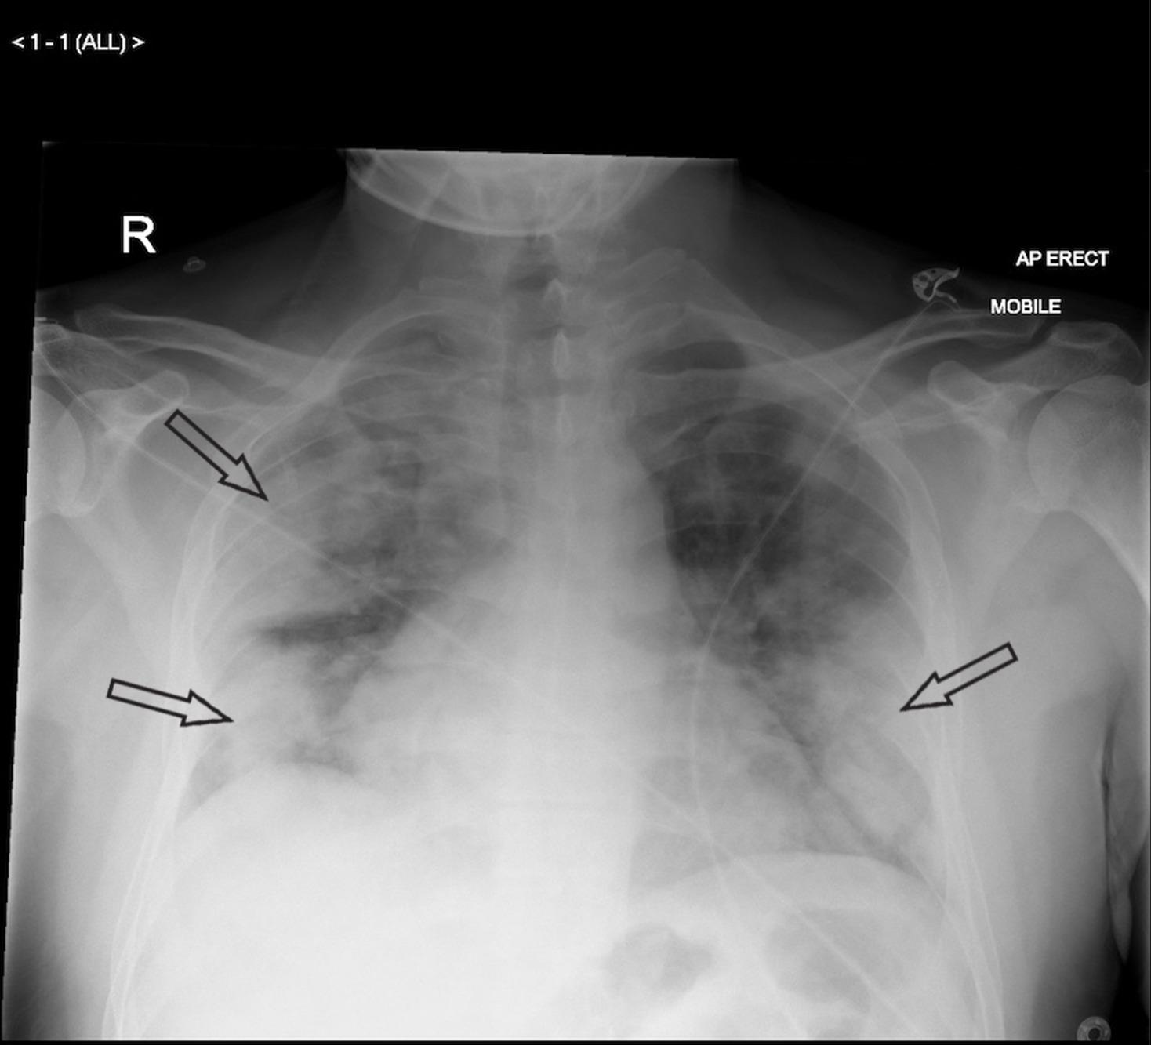
Severe COVID-19
32 year male, CKD, BMI- 35, CAD, hospitalized with COVID-19, RR-24, on 4l by NC, hospitalized
Recommendations:
Remdesivir IV X 5 days (conflicting data)
plus dexamethasone 6 mg IV/PO for up to 10 days or until hospital discharge
Or dexamethasone alone
Consider Tocilizumab/Baricitinib if increasing O2 requirement within first 24 hours

Slide 4
November 5, 2020 (NEJM)
1063 patients underwent randomization.
60 trial sites, 13 in the US
50% assigned to remdesivir and 50% to placebo
Remdesivir may be beneficial if given in the early viremic phase :
(<7-10 days from symptom onset or diagnosis)
Although recent data shows minimal impact on mortality
 | Remdesivir | Placebo
Median recovery time | 10 | 15
15 day mortality (estimates) | 6.7% | 11.9%
29 day mortality | 11.4% | 15.2%
Serious Adverse events | 24.6% | 31.6%
Notes:
Median recovery those who received remdesivir had a median recovery time of 11 days (95% confidence interval [CI], 9 to 12), as compared with 15 days (95% CI, 13 to 19) in those who received placebo (rate ratio for recovery, 1.32; 95% CI, 1.12 to 1.55; P<0.001). The Kaplan-Meier estimates of mortality by 14 days were 7.1% with remdesivir and 11.9% with placebo (hazard ratio for death, 0.70; 95% CI, 0.47 to 1.04). Serious adverse events were reported for 114 of the 541 patients in the remdesivir group who underwent randomization (21.1%) and 141 of the 522 patients in the placebo group who underwent randomization (27.0%

Slide 5
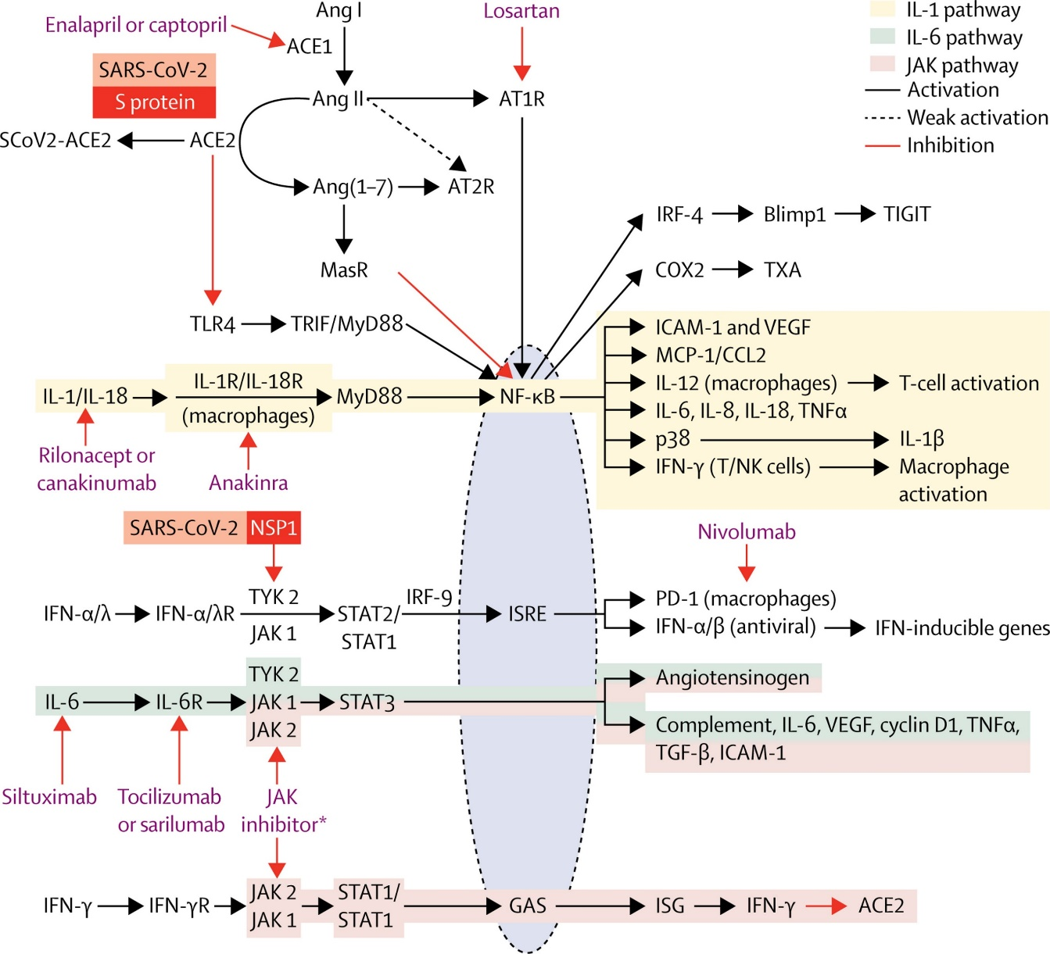
The Inflammatory Phase
Figure
The Lancet Respiratory Medicine DOI: (10.1016/S2213-2600(20)30226-5)
Copyright © 2020 Elsevier Ltd Terms and Conditions
Notes:
SARS-CoV-2 interaction with the inflammatory system and therapy targets within the system
TLR4, AT1R, IL-6, IL-1, IL-18, type 1 IFNs, and IFN-γ receptor binding activates specific signalling cascades and translocation of nuclear transcription factors into the nucleus (blue ellipse), where they interact with their respective chaperones (NF-KB) or their targeting sequences on DNA (ISRE, GAS) to activate the production of multiple proteins including additional cytokines, chemokines, cell surface molecules, and more. SARS-CoV-2 also directly interacts with ACE2 (via S protein) causing uninhibited Ang II activation of AT1R while also decreasing TLR4 inhibition; in addition, SARS-CoV-2 inhibits TYK 2 (vis NSP1), further driving inflammation by causing downstream effects that overlap with the immunomodulatory pathway. Anticytokine, JAK inhibitors, and antihypertensives can limit hyperinflammation by interacting and inhibiting these signalling cascades. ACE=angiotensin converting enzyme. Ang=angiotensin. ATR1=type 1 angiotensin II receptor. AT2R=type 2 angiotensin II receptor. COX=cyclooxygenase. GAS=IFN-γ activation site. ICAM=intercellular adhesion molecule. IL=interleukin. IFN=interferon. IRF=IFN regulatory factor. ISG=IFN-stimulated gene. ISRE=IFN-stimulated response element. JAK=Janus kinase. MCP=monocyte chemoattractant protein. NSP=non-structural protein. PD-1=programmed cell death 1. R=receptor. SARS-CoV-2=severe acute respiratory syndrome coronavirus 2. TGF=transforming growth factor. TLR=toll-like receptor. TNF=tumour necrosis factor. TRIF=TIR-domain-containing adapter-inducing interferon-β. TXA=thromboxane. TYK=tyrosine kinase. VEGF=vascular endothelial growth factor. *JAK inhibitors: ruxolitinib, tofacitinib, baricitinib, peficitinib, fedratinib, and upadacitinib.

Slide 6
Corticosteroids:
Randomized Evaluation of COVID-19 Therapy (RECOVERY) trial
 | Dexamethasone 6 mg daily + Standard of care | Standard care
Number of patients | 2104 | 4321
28 day all cause mortality | 21.6% | 24.6%
those requiring mechanical ventilation | 29.3 % | 41.4%
Discharged from hospital within 28 days | 67.2 % | 63.5%
The benefit was greatest in
    patients with symptoms > 7 days (the inflammatory phase)
    patients who required mechanical ventilation.
    No benefit among patients not on supplemental O2

Slide 7
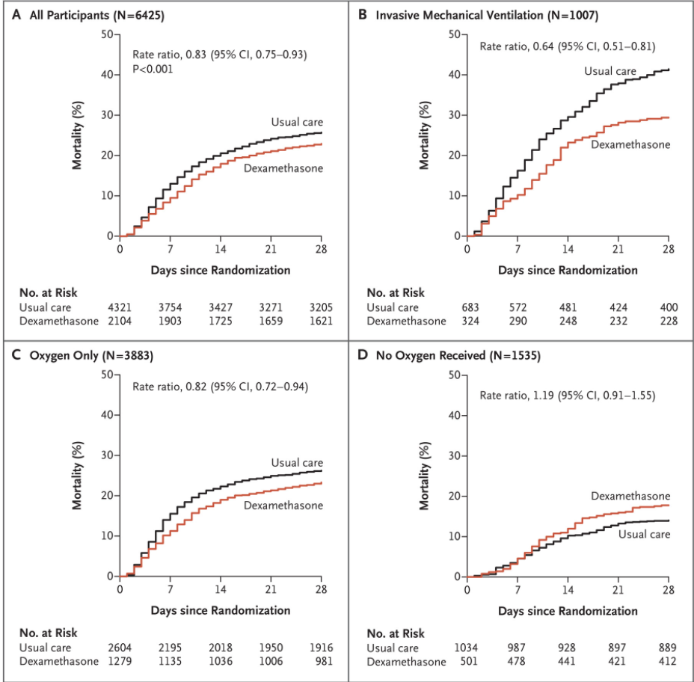
Corticosteroids- Recommendations based on RECOVERY Trial
Yes in hospitalized, critically ill patients
        Odds of mortality at 28 days is 34% lower in the dexamethasone group
Yes in hospitalized patients with severe COVID-19
        28-day mortality was 17% lower in the dexamethasone group
No in hospitalized patients with COVID-19 without hypoxemia
Dose
  Dexamethasone 6 mg IV or PO for 10 days (or until discharge if earlier)
      Or Equivalent total daily doses of alternative glucocorticoids
      methylprednisolone 32 mg and prednisone 40 mg.

Slide 8
IL-6R Inhibitors
Tocilizumab
  Recombinant humanized anti-interleukin (IL)-6 receptor monoclonal antibody
Currently approved by the FDA
  Certain rheumatologic disorders
  Cytokine release syndrome induced by chimeric antigen receptor T cell (CAR-T cell) therapy.
Hypothesized that modulating the levels of proinflammatory IL-6 may reduce the duration and/or severity of COVID-19 illness

Slide 9
Tocilizumab- Studies showing no benefit
RCT-TCZ-COVID-19 (n=126)
    Primary end point- hypoxia, ICU admission or death- Stopped early due to lack of benefit
TOCIBRAS (January 2021)
  Tocilizumab (n=65) + SoC vs SoC Alone (n=64)
    DSMB stopped trial early
    Increased mortality at day 15 in Toci vs SOC arm
      17% vs 3%
CORIMUNO-19-TOCI(n=131)
    Toci may have reduced need for mechanical ventilation, but no impact on mortality
BACC Bay Trial(n=243)- 7 Boston hospitals
    Placebo controlled; Toci did not reduce requirement for intubation or reduce mortality
COVACTA trial (452 patients)
    First global, randomised, double-blind, placebo-controlled phase III study
    No difference in patient mortality at week 4
Empacta (n=389)
    Placebo controlled
    Toci reduced need for mechanical ventilation (19% vs 12.5%)
    No difference in 28 day mortality

Slide 10
Tocilizumab- Studies showing benefit
TESEO Cohort
    Tocilizumab to Treat Severe COVID-19 in Italy
    Retrospective cohort study 179 in Toci arm vs 365 in SOC arm
RECOVERY- (2000 patients in Toci arm) vs (2000 in standard of care arm)
    Reduction in mechanical ventilation 12% vs 15%
    Reduction in 28 day mortality if given with steroids- 27% vs 33%
REMAP-CAP Trial (n =800 )
    Patients started on IL-6 antagonist within 24 hours of ICU admission
    Reduced mortality in IL-6 arm

Slide 11
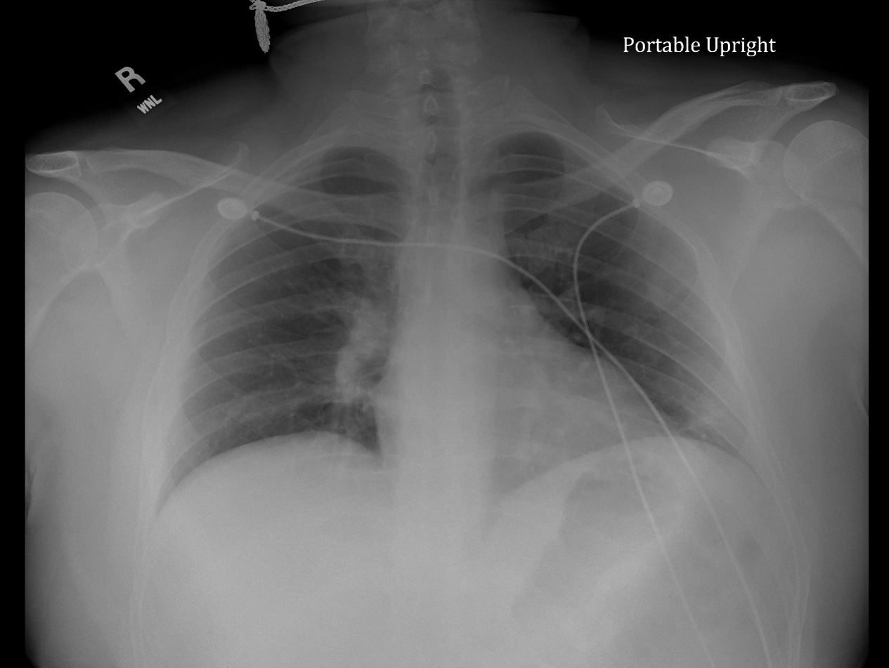
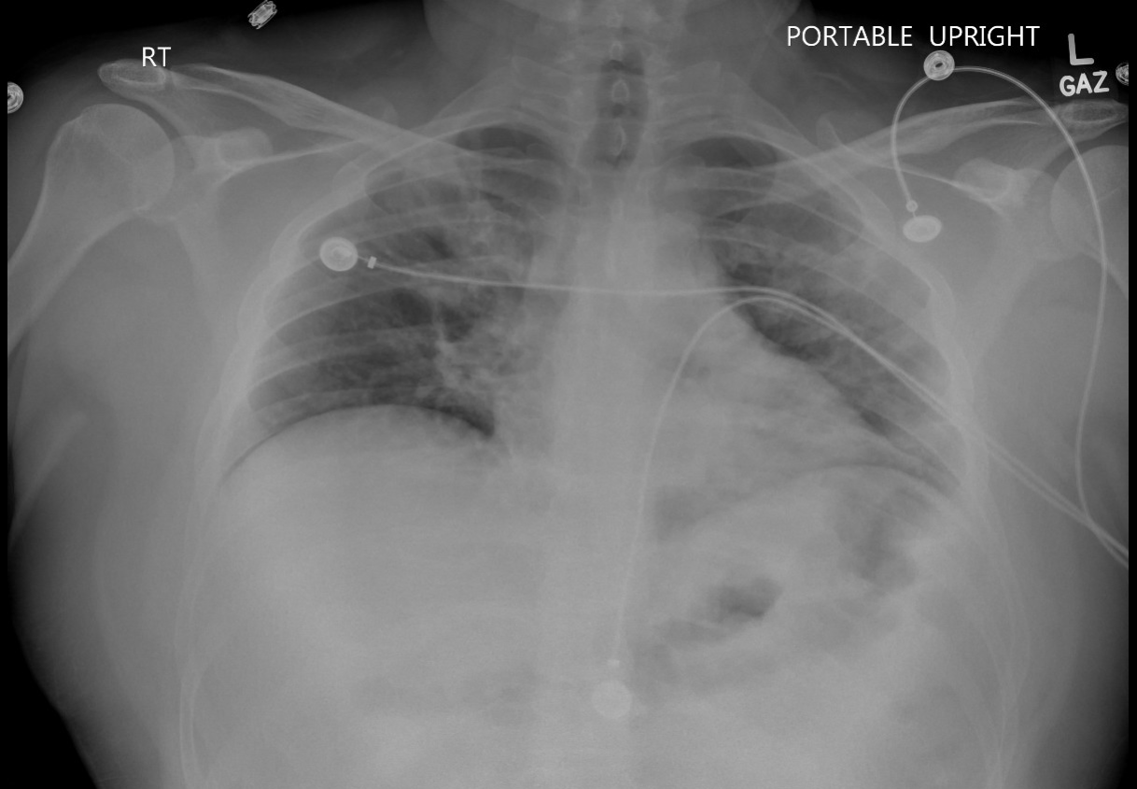
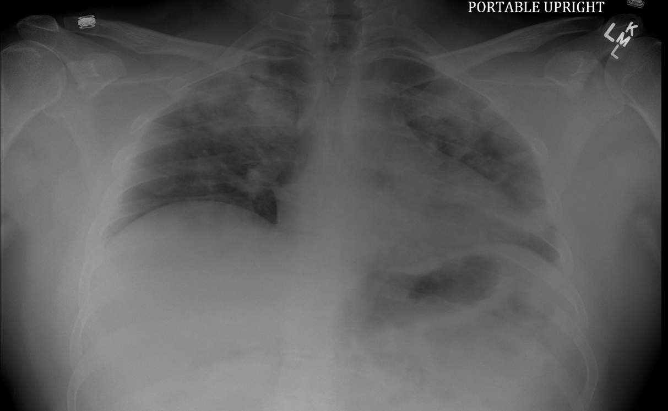
Medical resident
COVID diagnosed 3 days earlier
Febrile , tachycardic for 4 days

Slide 12
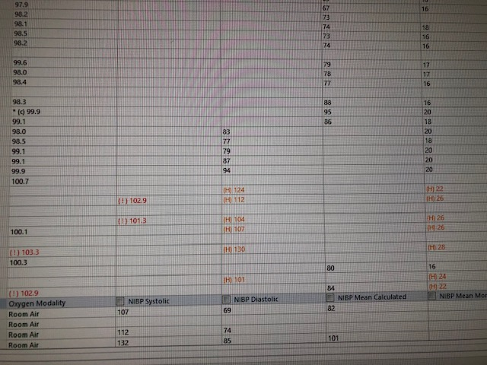
Same resident
Tocilizumab given at 8:30pm

Slide 13
NIH guidance
Patients Who Require High-Flow O2 or noninvasive Ventilation
Recommendations
  Dexamethasone alone ; or
  Dexamethasone plus remdesivir.
For worsening patients within 3 days of hospital admission and have increased markers of inflammation
Add baricitinib (JAK-1 and JAAK-2) or
Tocilizumab (IL-6 antagonist)

Slide 14
Treatment options for mild COVID-19 to prevent progression and hospitalization

Slide 15
Anti-SARS-CoV-2 Monoclonal Antibodies for the Treatment of COVID-19
Anti-SARS-CoV-2 monoclonal antibody regimens to treat non hospitalized patients with mild to moderate COVID-19 who are at high risk of clinical progression:
  Bamlanivimab 700 mg plus etesevimab 1,400 mg IV infusion or
  Casirivimab 600 mg plus imdevimab 600 mg IV infusion or SQ injection or
  Sotrovimab 500 mg IV infusion

Slide 16
Monoclonal Antibodies for the Treatment of COVID-19
The recommendations are based on the following criteria from the FDA EUAs:
      Patients with high-risk conditions that were represented in clinical trials and
      Patients with other medical conditions and factors that had limited representation in clinical trials
Outpatients:
    Treatment should be started as soon as possible after the patient receives a positive result
      Within 10 days of symptom onset but preferably within 4-7 days
Hospitalized patients
      Can be considered for patients with mild to moderate COVID-19 who are hospitalized for a reason other than COVID-19 if they otherwise meet EUA criteria for outpatient treatment.
      Monoclonal antibodies are not currently authorized for hospitalized with severe COVID-19
      However, they may be available through EUA for patients who have not developed an antibody response

Slide 17
Monoclonal antibody-Emergency Authorization
Anti-SARS-CoV-2 monoclonal antibodies to treat outpatients with mild to moderate COVID-19 who are at high risk of clinical progression,
Reduced activity of monoclonal antibodies against COVID-19 caused by variants with the L452R or E484K substitution in the spike protein.
L452R is present in: B.1.526.1, B.1.427, B.1.429.
  E484K is present in:
  B.1.525, P.2, P.1, B.1.351, B.1.1.7
Product | hospitalizations or death in the antibody arm | hospitalizations or death placebo arm
Casirivimab-imdevimab (single IV infusion) | 1.3% | 4.6%
Sotrovimab (single IV infusion) | 1% | 7%
Bamlanivimab-etesevimab (IV infusion) | 2% | 7%

Slide 18
SC Monoclonal Antibody Utilization Summary
Over 19,000 patients with symptomatic COVID successfully treated to date in SC
Only about 40 patients unable to complete treatment
No documentation of anaphylactic reaction or other serious adverse event
15 new treatment sites have been added to our state network over the past 4-6 weeks
Estimated number of COVID hospital admissions prevented > 2075
Estimated number of COVID deaths prevented to date > 200

Slide 19
COVID-19 treatment guidelines when there are logistical constraints
3
While there are currently no shortages of these monoclonal antibodies, logistical constraints (e.g., limited space, not enough staff who can administer therapy) can make it difficult to administer these agents to all eligible patients. In situations where it is necessary to triage eligible patients, the Panel suggests:
  Prioritizing the treatment of COVID-19 over PEP of SARS-CoV-2 infection.
  Prioritizing the following groups over vaccinated individuals who are expected to have mounted an adequate immune response:
    Unvaccinated or incompletely vaccinated individuals who are at high risk of progressing to severe COVID-19
    Vaccinated individuals who are not expected to mount an adequate immune response (e.g., immunocompromised individuals).
    PREGNANT women (vaccinated or unvaccinated)

Slide 20
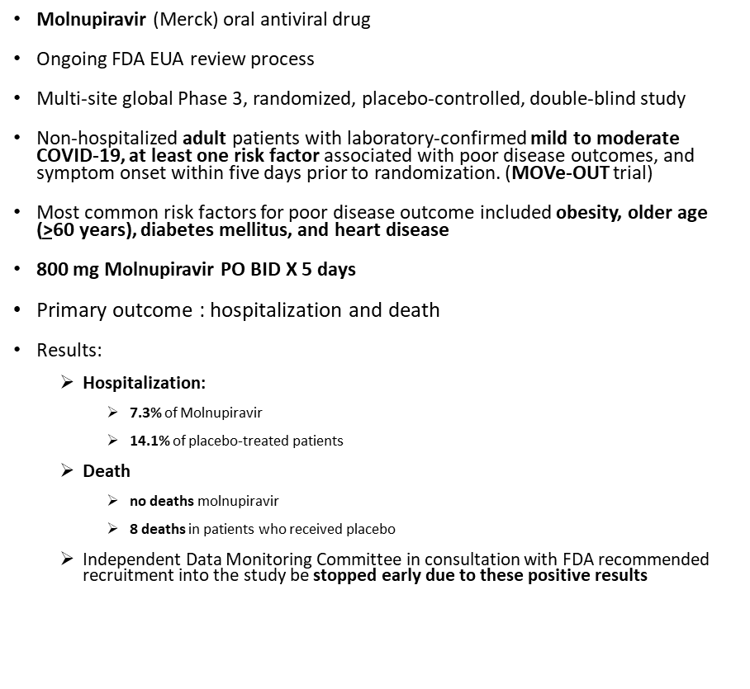

Slide 21
Treatment option to prevent infection after significant exposure

Slide 22
EXPANDED FDA APPROVAL of REGEN-COV: POST-EXPOSURE PROPHYLAXIS
This expanded EUA covers post-exposure prophylaxis in adults and children > 12 at high risk for progression to severe COVID, and are:
  Not fully vaccinated or who are not expected to mount an adequate immune response to full COVID vaccination, including individuals that are immunocompromised or immunosuppressed and
  Have been exposed to an individual infected with SARS-CoV-2 consistent w/ CDC close contact criteria or
  Who are at high risk of exposure to an individual infected with SARS-CoV-2 in an institutional setting where COVID infections have been documented

Slide 23
Additional Key Information about Molnupiravir
Molnupiravir is also being evaluated for post-exposure prophylaxis in MOVe-AHEAD, a global, multicenter, randomized, double-blind, placebo-controlled Phase 3 study, which is evaluating the efficacy and safety in preventing the spread of COVID-19 within households

Slide 24
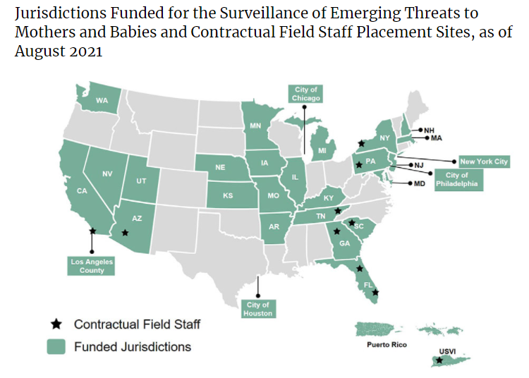
SET NET
Surveillance for Emerging Threats to Mothers & Babies
CDC’s Surveillance
  COVID-19
  hepatitis C
  syphilis
  Zika

Slide 25
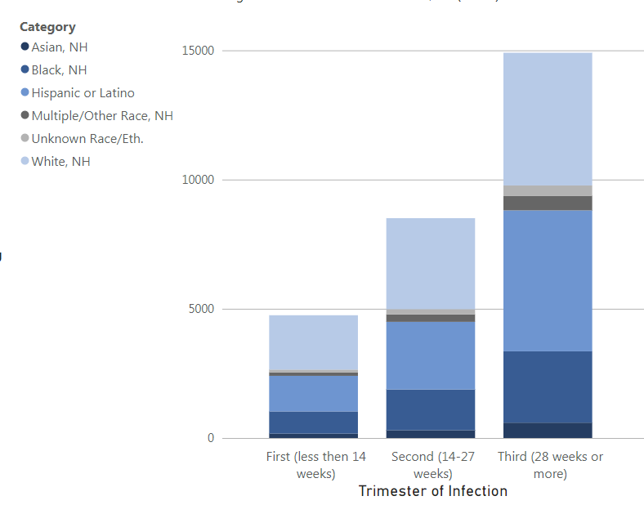
Data on COVID-19 during Pregnancy
29,025 women who completed pregnancy
29,266 live born infants
266 pregnancy losses

Slide 26
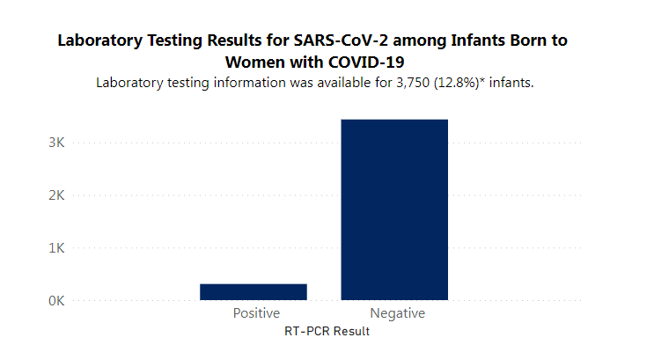
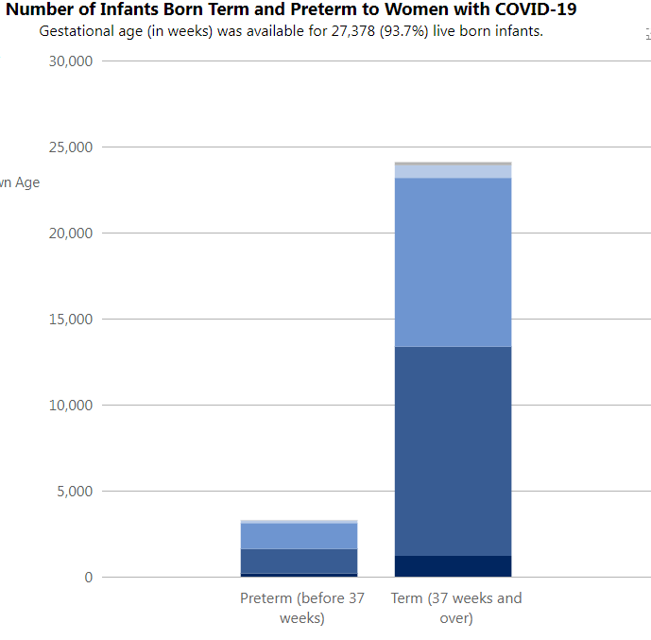

Slide 27
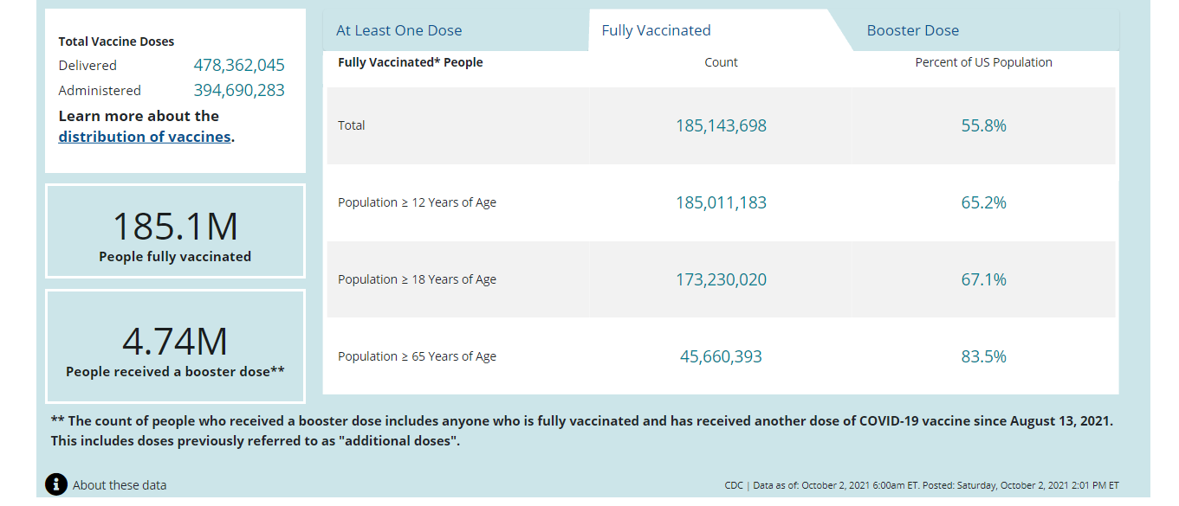
US Vaccination status

Slide 28
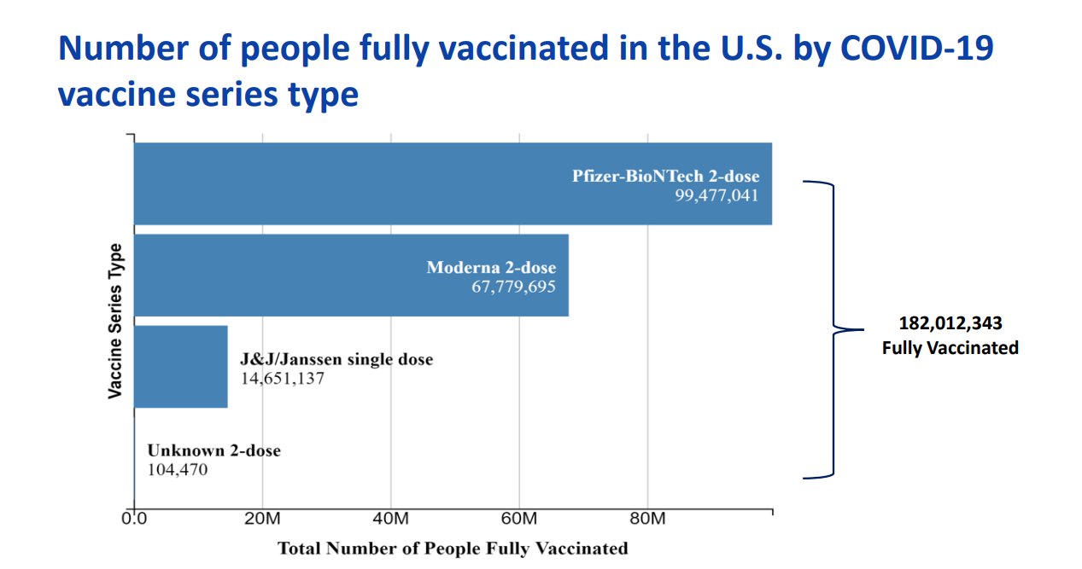

Slide 29
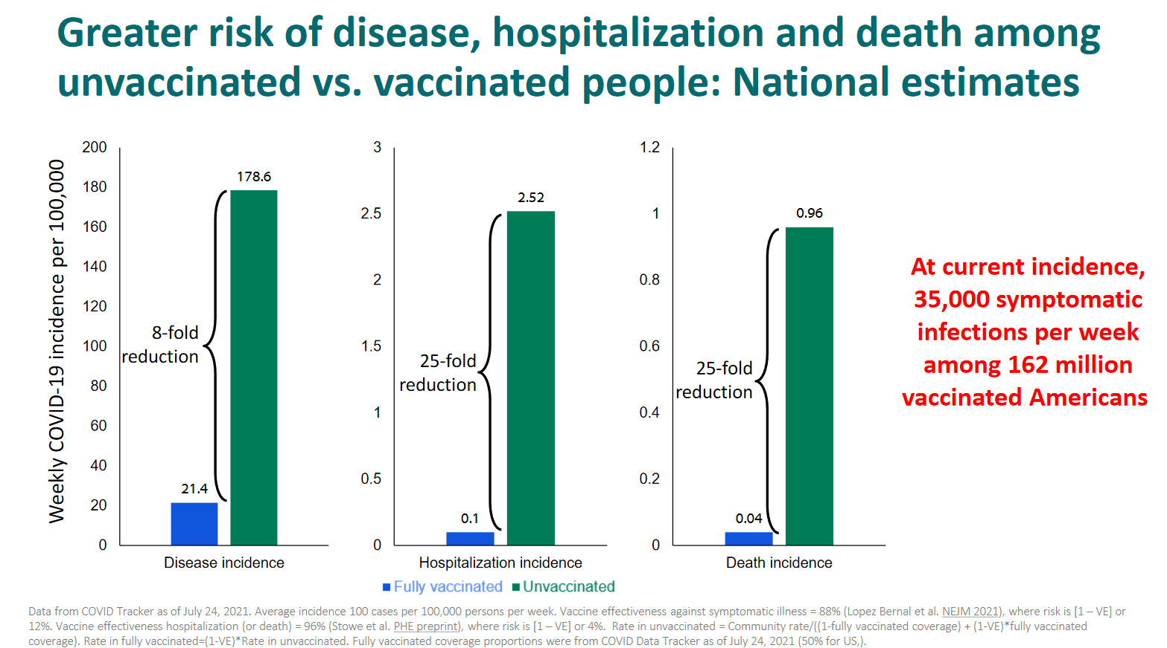

Slide 30
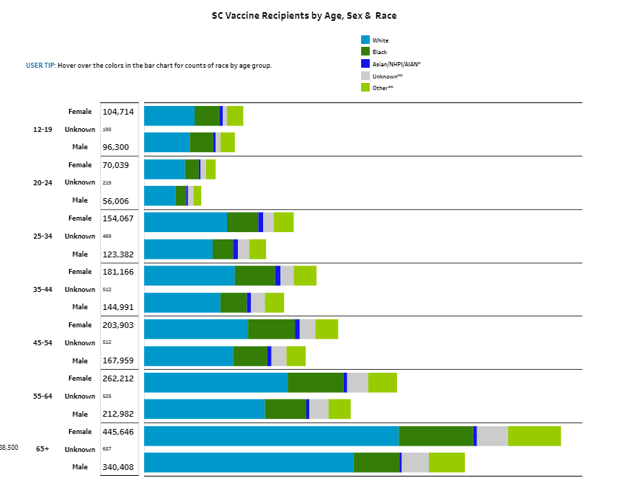
27.7% fully vaccinated
28.0% fully vaccinated

Slide 31
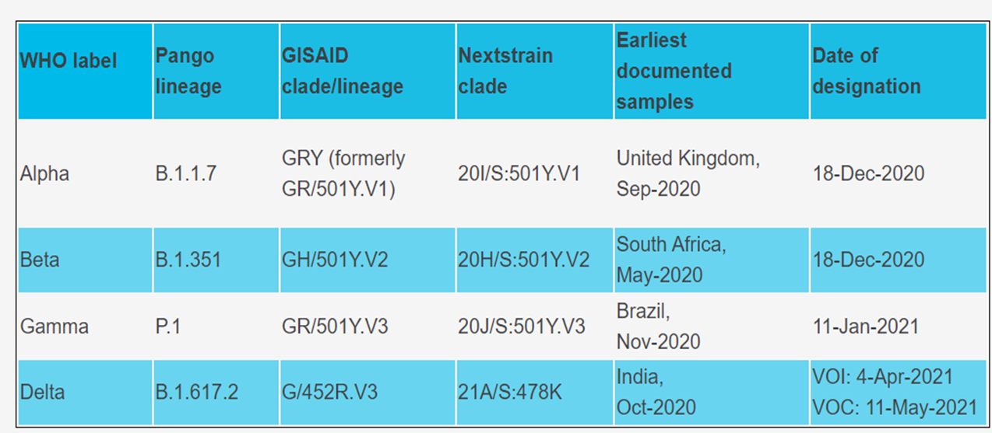
Variants- Greek alphabet soup
Variant Being Monitored (VBM)
  Alpha (B.1.1.7, Q.1-Q.8)
  Beta (B.1.351, B.1.351.2, B.1.351.3)
  Gamma (P.1, P.1.1, P.1.2)
  Epsilon (B.1.427 and B.1.429)
  Eta (B.1.525)
  Iota (B.1.526)
  Kappa (B.1.617.1)
  B.1.617.3
  Mu (B.1.621, B.1.621.1)
  Zeta (P.2)
Variant of Interest (VOI)
Variant of Concern (VOC)
  Delta (B.1.617.2 and AY.1 sublineages)
Variant of High Consequence (VOHC)

Slide 32
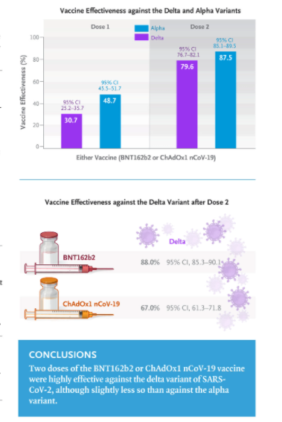
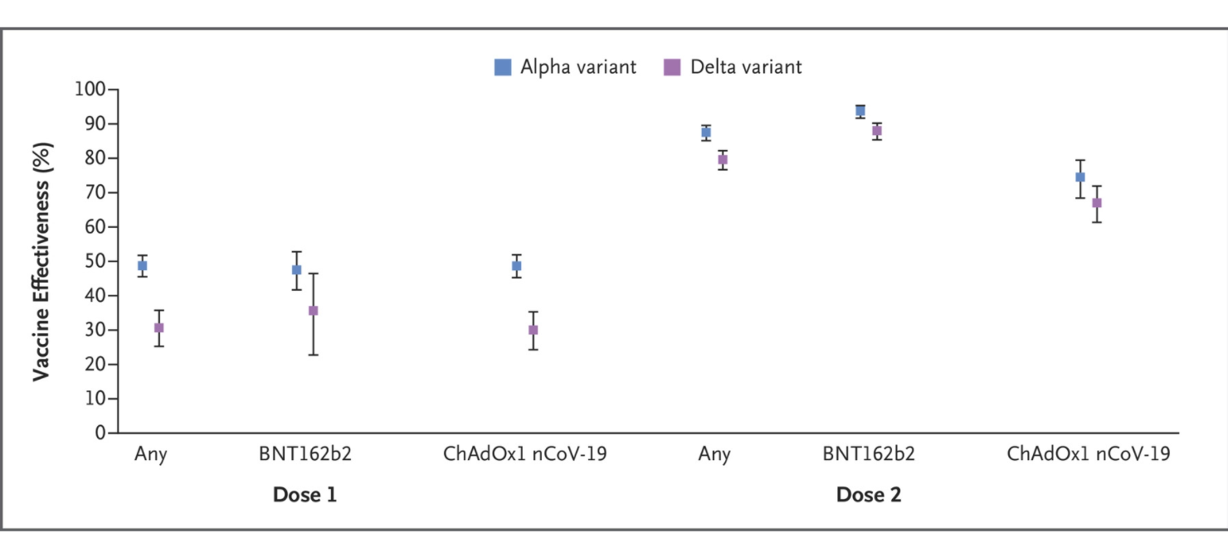
Vaccine Effectiveness against the Alpha and Delta Variants
August 12,2021

Slide 33
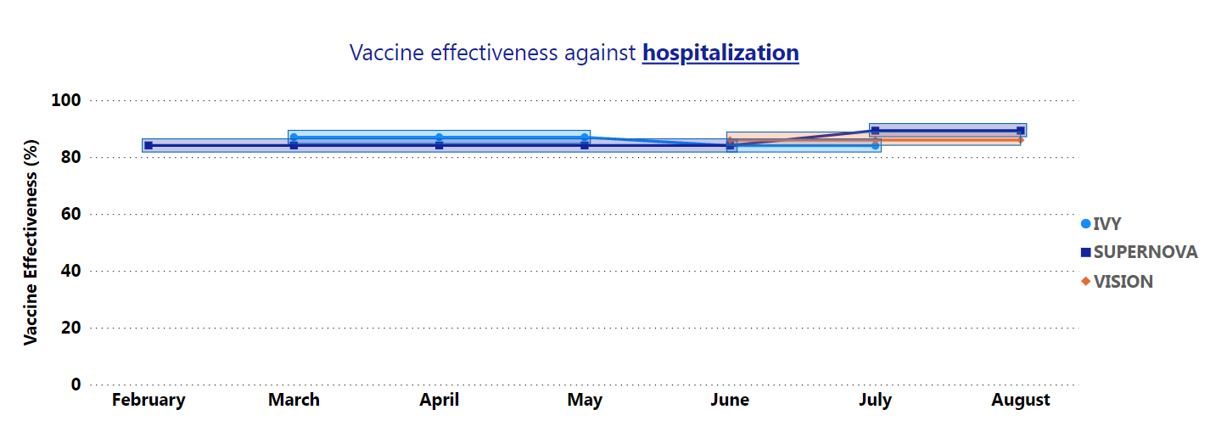
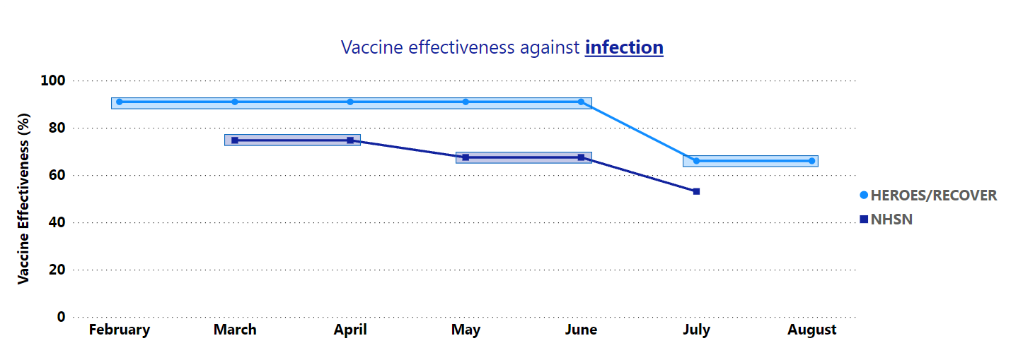

Slide 34
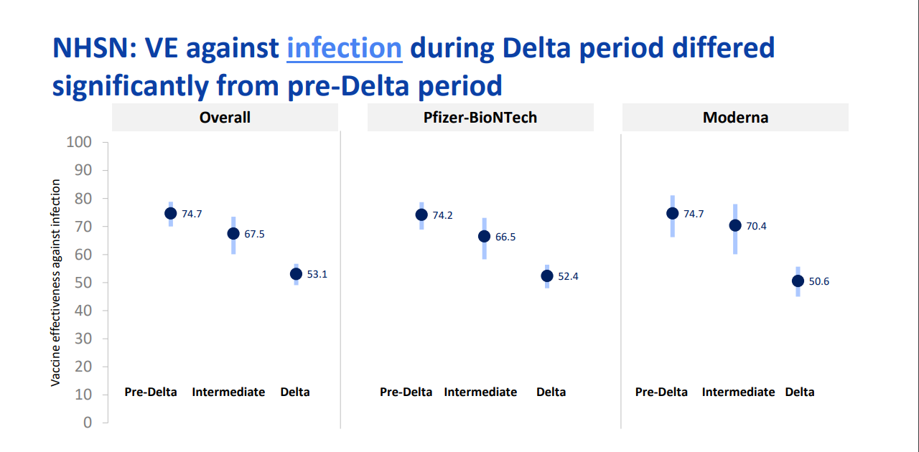

Slide 35
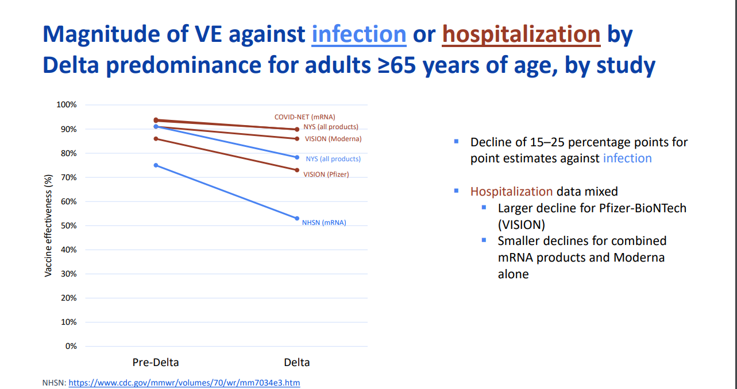

Slide 36
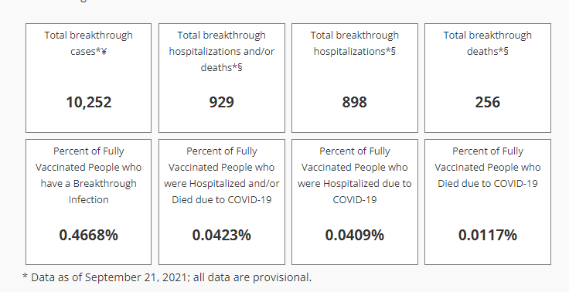
Breakthrough cases are rare
https://scdhec.gov/covid19/covid-19-data/breakthrough-cases-tracking-disease-infection-after-vaccination

Slide 37
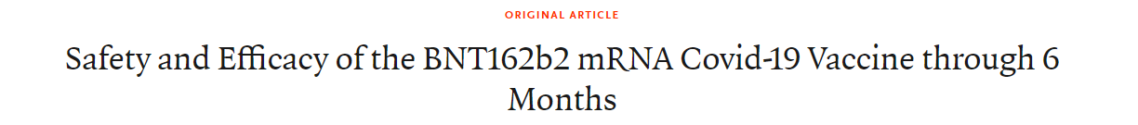
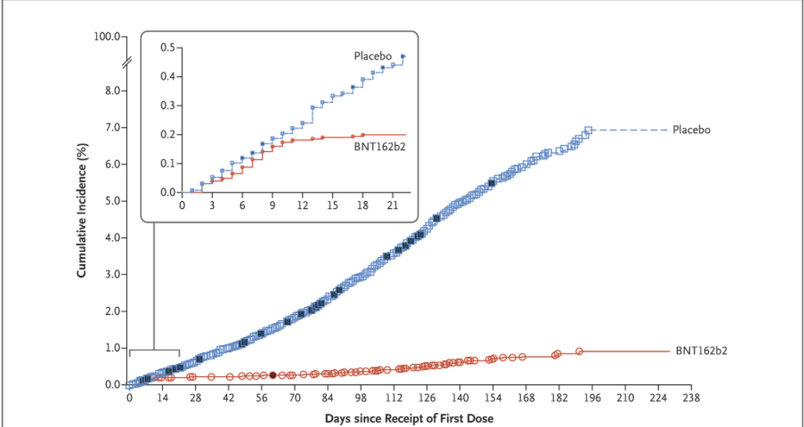
Efficacy of BNT162b2 against Covid-19

Slide 38
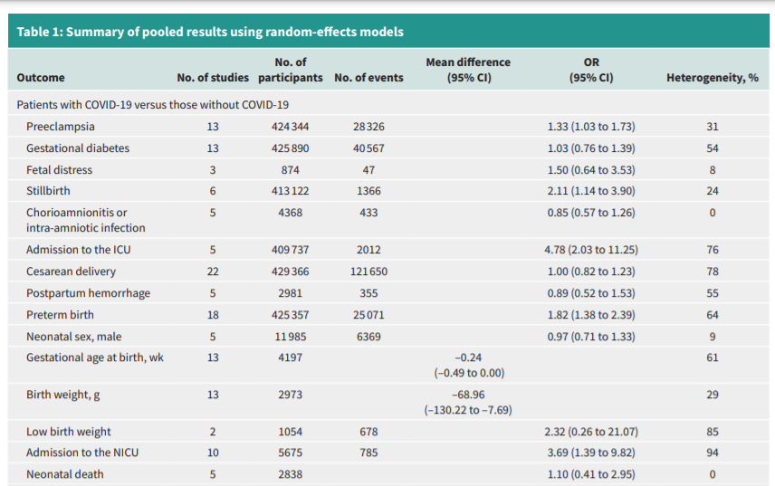
Summary of many studies of COVID-19 disease and pregnancy outcomes
>2 times higher risk of stillbirth
>3 ½ times higher risk of baby going to Neonatal ICU
>4 ¾ times risk of mother going to the ICU
COVID is a bad disease in pregnancy
https://www.cmaj.ca/content/cmaj/193/16/E540.full.pdf

Slide 39
American College of Obstetricians and Gynecologists (ACOG)- COVID Recommendations
All eligible persons greater than age 12 years, including pregnant and lactating individuals, receive a COVID-19 vaccine or vaccine series.
For patients who do not receive the vaccine, the discussion should be documented in the patient’s medical record.
COVID-19 vaccines may be administered simultaneously with other vaccines, including within 14 days of receipt of another vaccine
  This includes influenza and Tdap.
Third Dose:
  Moderately to severely immunocompromised people should receive a third dose of the Pfizer-BioNTech and Moderna mRNA COVID-19 vaccines at least 28 days after the completion of the initial mRNA COVID-19 vaccine series.
Insufficient data to recommend second dose of Johnson & Johnson’s Janssen COVID-19 vaccine
Booster Dose:
  Individuals aged 18 - 64 years at high risk of severe COVID-19 are eligible for a COVID booster.
  ACOG recommends that pregnant people, including pregnant health care workers, receive a booster dose of the Pfizer-BioNTech COVID-19 vaccine at least 6 months following the completion of their initial Pfizer-BioNTech COVID-19 vaccine series.

Slide 40
Joint Statement Recommending COVID-19 Vaccination of All Pregnant Women in South Carolina
SIGNATORIES (Listed Alphabetically)
American Academy of Family Physicians, South Carolina Chapter
American Academy of Pediatrics, South Carolina Chapter*
American College of Obstetrics and Gynecology, South Carolina Chapter
Association of Women’s Health, Obstetric and Neonatal Nurses, South Carolina Section*
South Carolina Birth Outcomes Initiatives*
South Carolina Children’s Hospital Collaborative
South Carolina Department of Health and Environmental Control
South Carolina Department of Health and Human Services*
South Carolina Hospital Association
South Carolina Medical Association*
South Carolina Office of Rural Health
South Carolina Perinatal Association
South Carolina Primary Health Care Association
*Signatories added August 13, 2021.

Slide 41
COVID and Breast Feeding
JAMA- April 12,2021; Israel
Breast feeding women vaccinated with Pfizer , 2 doses, 21 days apart
84 women, weekly breast milk tested samples for 6 weeks for IgA and IgG
SARS-CoV-2 IgA antibodies
  2 weeks after the first vaccine -62%
  4 weeks- 86%
IgG
  Low for 3 weeks then at 4 weeks > 90% positive in breast milkad

Slide 42

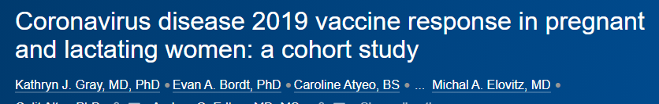
Do vaccines prevent infection in pregnant women?
Retrospective cohort study within the pregnancy registry - Israel.
Pregnant women vaccinated with a first dose from December 2020- February 2021
1:1 matched to unvaccinated women by age, gestational age, residential area, population subgroup, parity, and influenza immunization status
The primary outcome was PCR + SARS-CoV-2 infection >28 days after the first vaccine
7530 vaccinated and 7530 matched unvaccinated women
46% and 33% in the second and third trimester, respectively
At 30 days follow up:
  118 SARS-CoV-2 infections in the vaccinated group and 202 in the unvaccinated group.
During 28 to 70 days of follow-up
  10 infections in the vaccinated group and 46 in the unvaccinated group

Slide 43
Are there increased adverse effects of vaccine in pregnancy

Slide 44
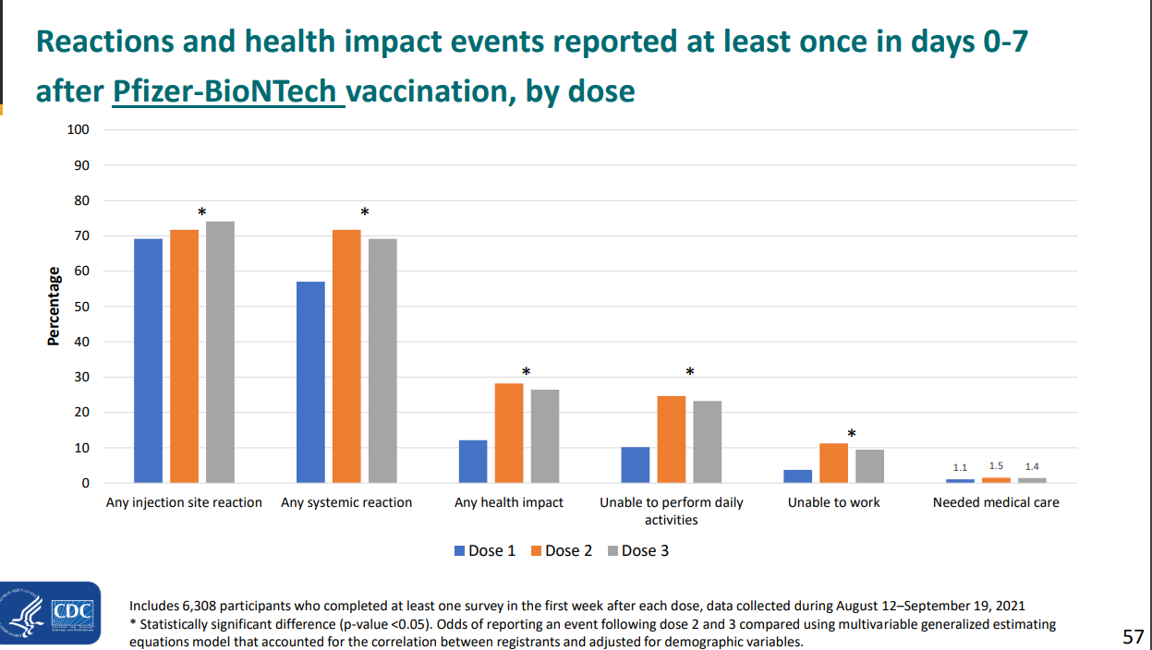

Slide 45
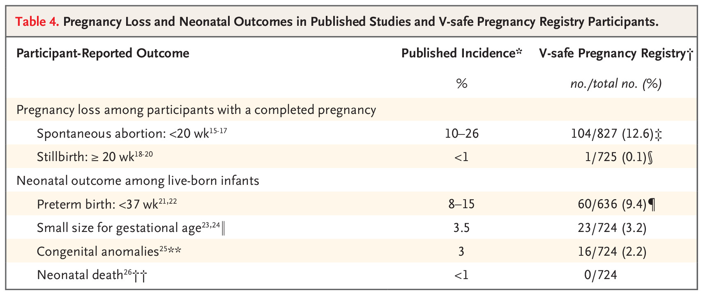
Analysis of 35,691 pregnancies: no increased risk of miscarriage, stillbirth, or adverse fetal outcomes with COVID vaccine
https://www.nejm.org/doi/full/10.1056/nejmoa2104983

Slide 46
Third dose COVID vaccine
Additional dose for the immunocompromised because they don’t have strong response to original series
Booster dose would be to boost immunity for this who did respond but now immunity wanes

Slide 47
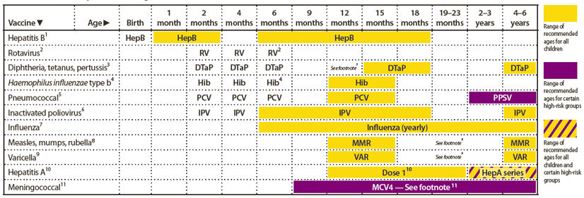
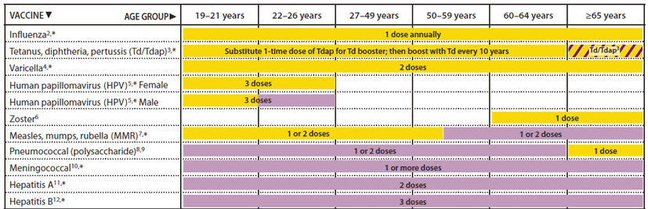
Many vaccines require boosters

Slide 48
CDC recommendations for booster
Should receive a booster shot of Pfizer-BioNTech’s COVID-19 vaccine at least 6 months after their Pfizer-BioNTech primary series:
People 65 years and older and residents in long-term care settings
People aged 50 to 64 with certain underlying medical conditions
May receive a booster shot…based on their individual benefits and risks:
People 18 to 49 who are at high risk for severe COVID-19 due to certain underlying medical conditions
People aged 18-64 years who are at increased risk for COVID-19 exposure and transmission because of occupational or institutional setting *

Slide 49
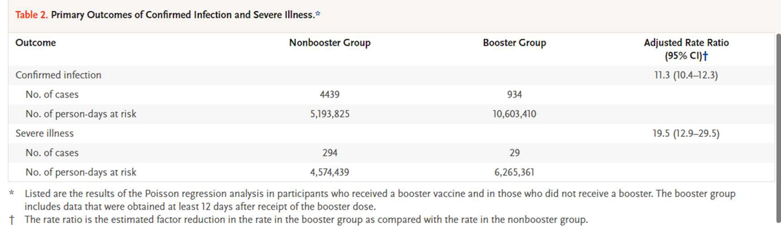
NEJM , Sep 15, 2021
All participants were 60 years of age or older
Had received two doses of the BNT162b2 vaccine at least 5 months earlier
Outcomes: Confirmed infection or severe disease
Results:
> 12 days after the booster dose

Slide 50
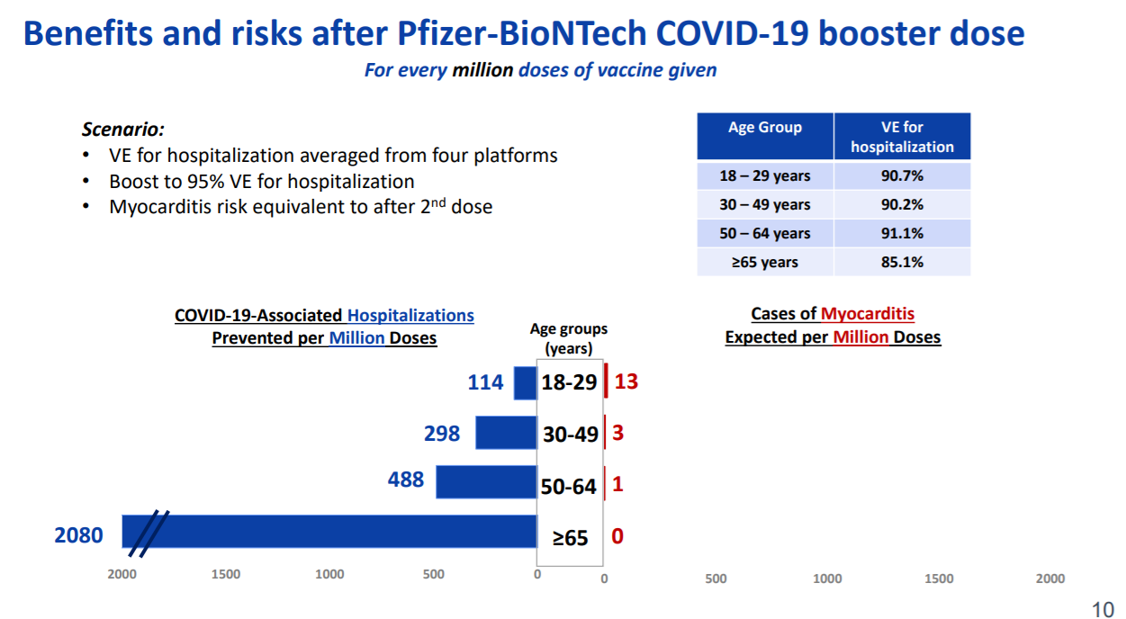

Slide 51
FAQ
What if vaccinated with Moderna or J&J?
  Moderna submitted EUA application for booster Sept 1
  Need more data on mixing doses
Should pregnant persons get booster?
  Falls in the category of may be vaccinated: 18-49 year old with medical condition that places them at higher risk
Who is in the increased occupational risk group?
  Teachers, workers in day care, grocery store, or health care settings; this
Need a doctor referral?
  No, self-attestation is all that is needed

Slide 52
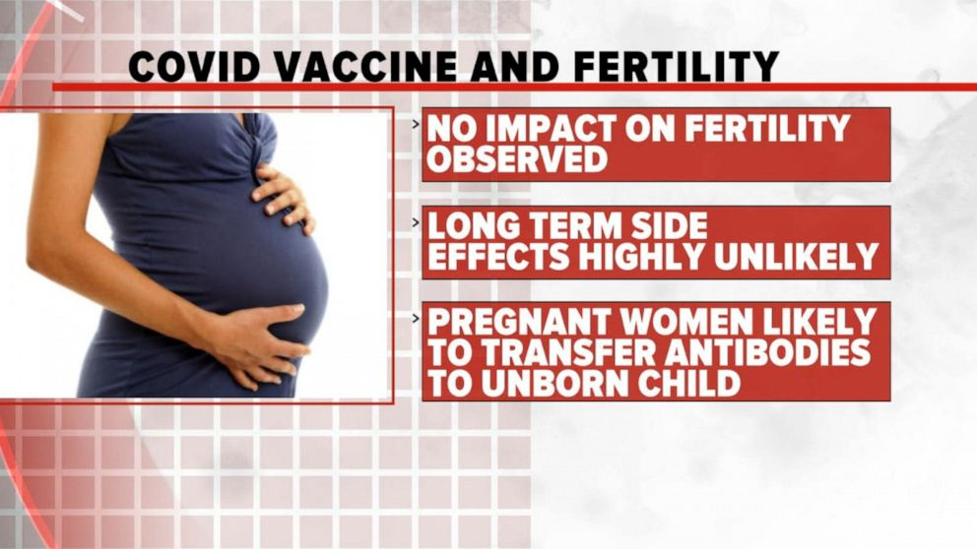
During the Pfizer vaccine studies, 23 women volunteers became pregnant, and the only one who suffered a pregnancy loss was in the placebo group

Slide 53
COVID Delta Variant
Spike protein mutations:
Decreased immune response
  Key mutations in RBD: 452 and 478
  Also deletion of the N-terminal domain
Increased replication
  P618R at the S1-S2 cleavage site
NEJM study Aug 12,2021
  Effectiveness of Pfizer (and AstraZeneca) vaccine – 30% after 1 dose against delta
  88% after 2 doses

Slide 54
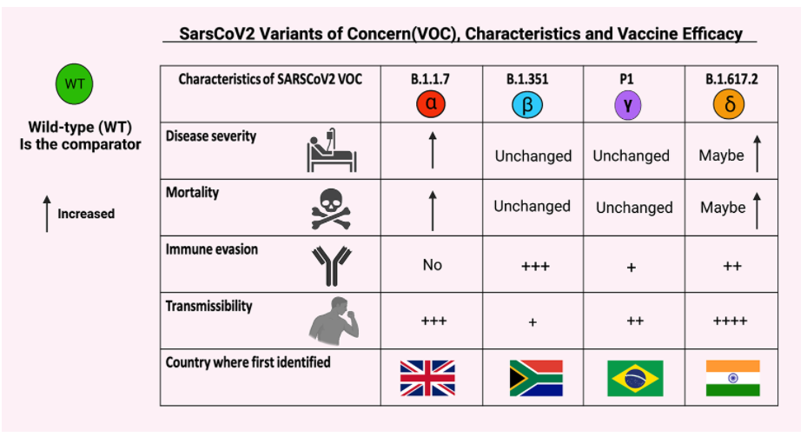

Slide 55
Coronavirus disease 2019 vaccine response in pregnant and lactating women: a cohort study
American Joutnal of OB/Gyn (Gray et al, Sep 2021)

Slide 56
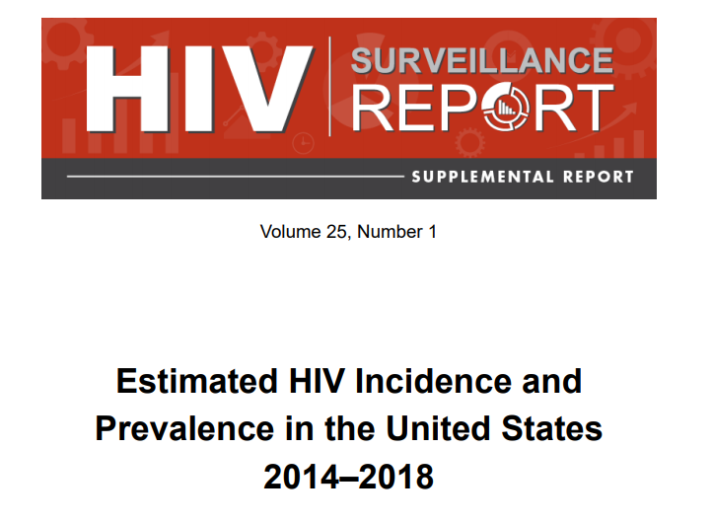
US population- 330 million
Patients with HIV -estimated 1.2 million
Simple Math:
HIV prevalence >1/330 Americans
  Males- 0.7% (1/150 male Americans)
  Females-0.2%

Slide 57
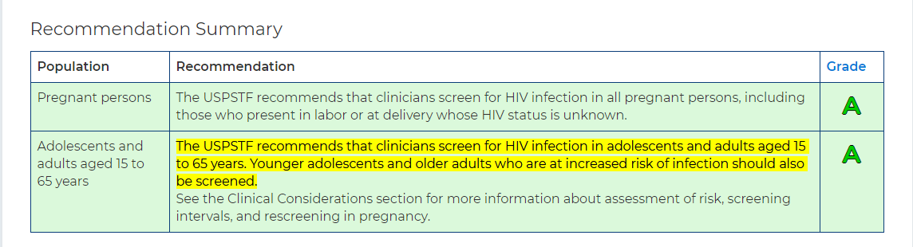
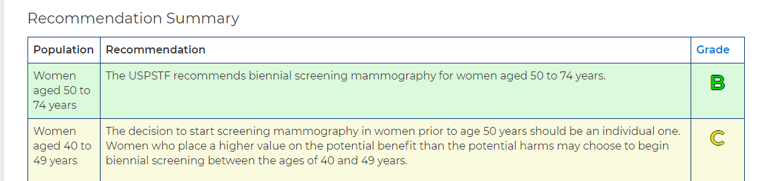
United States Preventive Services Task Force recommendations
GRADE A for HIV
GRADE B for BREAST CANCER SCREEING

Slide 58

Recommendations for Initiating ART for an HIV infected person
ART (Antiretroviral therapy or HIV medications) is recommended for all HIV-infected individuals to reduce the risk of disease progression.
Effective ART reduces transmission to almost “0”
HIV is easier to treat than Diabetes, COPD, CHF
Undetectable= Untransmissible

Slide 59

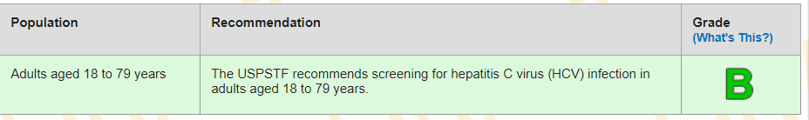
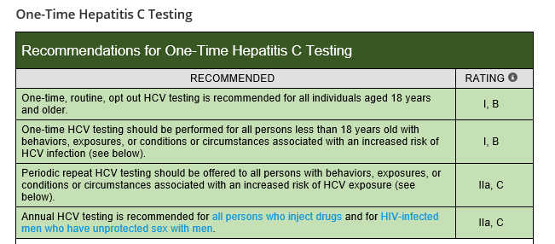
Hepatitis C Screening Recommendations

Slide 60
Treatment of Chronic HCV
Treatment is recommended for ALL pts with chronic HCV
      Exception: life expectancy likely to be < 6 months
Goal of Treatment is - Sustained Virological Response
    SVR- equal to cure/eradication
  SVR is defined as
      Undetectable HCV viral Load ≥12 weeks after treatment completion
SVR is associated with
    >70% reduction in the risk of Hepatocellular carcinoma
    90% decrease in liver-related mortality & liver transplantation
Van der Meer AJ, et al. JAMA. 2012;308(24):2584-2593
Current Directly acting antivirals have SVR > 98%
    1-3 tablets, once a day, for 8-12 weeks
    Very well tolerated

Slide 61
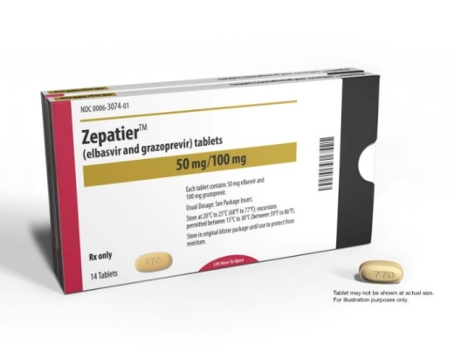
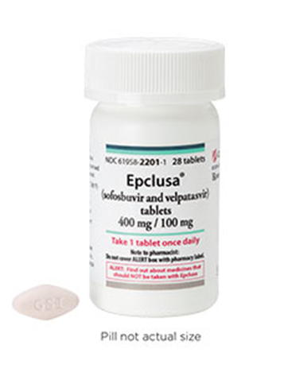
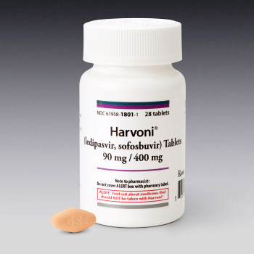
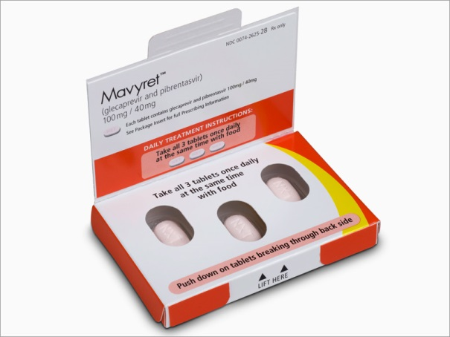
Treatment options for HCV
4 highly potent DAA combination regimens

Slide 62
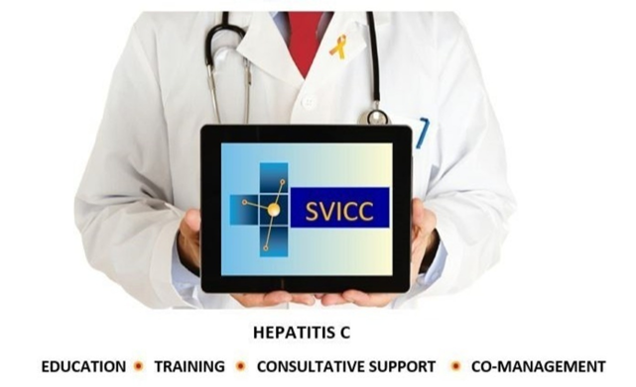
Monthy 1st and 3rd Wednesday and 4th Wednesday
12:00pm-1:00pm EST 12:00pm-1:00pm CST
11:00am-12:00pm CST 01:00pmpm-2:00pm EST
09:00am-10:00am PST 10:00am-11:00am PST
South East Viral Hepatitis Interactive Case Conference

