Slide 1
DOMESTIC VIOLENCE
Donna D. Johnson, MD

Slide 2


Slide 3
WHO IS AT RISK: ANYONE!
Every community
Every gender
Any age
Rich or poor
Race
Religious or not
Ethnicity
Sexual Orientation
Educational background
ACOG, CO #518

Slide 4
IS DV COMMON?
YES!
One out of three women
  Rape
  Physical violence
  Stalking
Almost 5 M cases reported each year
YOU KNOW SOMEONE WHO HAS BEEN ABUSED

Slide 5
HURT, INSULT, THREATEN, and SCREAM (HITS)
How often does your partner: Physically hurt you?
Insult you or talk down to you?
Threaten you with harm?
Scream or curse at you?
Likert Scale: 1-5
Score > 10: positive
Sensitivity: 30%–100%
Specificity: 86%–99%
Kevin Sherin, MD, MPH
Rabin, Am J Prev Health, 2009

Slide 6
WOMAN ABUSE SCREENING TOOL: WAST
In general, how would you describe your relationship—a lot of tension (3), some tension (2), no tension (1)?
Do you and your partner work out arguments with great difficulty (3), some difficulty (2), or no difficulty (1)?
Brown, Fam Med, 1996

Slide 7
WOMAN ABUSE SCREENING TOOL: WAST
Do arguments ever result in you feeling down or bad about yourself?
Do arguments ever result in hitting, kicking, or pushing?
Do you ever feel frightened by what your partner says or does?
Has your partner ever abused you physically?
Has your partner ever abused you emotionally?
Has your partner ever abused you sexually?
Responses: Often (3), sometimes (2), never (1)
Score of 13 positive
Sensitivity: 47-93%
Specificity: 56-96%
Brown, Fam Med, 1996
Rabin, Am J Prev Health, 2009

Slide 8
Partner Violence Screen (PVS)
Have you been hit, kicked, punched, or otherwise hurt by someone in the past year? If so, by whom?
Do you feel safe in your current relationship?
Is there a partner from a previous relationship who is making you feel unsafe now?
Any positive response denotes abuse
Sensitivity: 35-79%
Specificity: 80-94%
Feldhaus, JAMA, 1997
Rabin, Am J Prev Health, 2009

Slide 9
Abuse Assessment Screen (AAS)
Have you ever been emotionally or physically abused by your partner or someone important to you?
Within the last year, have you been hit, slapped, kicked, or otherwise physically hurt by someone? If yes, by whom? How many times?
Since you have been pregnant, have you been hit, slapped, kicked, or otherwise physically hurt by someone? If yes, by whom? How many times and where?
In the last year, has anyone forced you to have sexual activities? If so, whom? How many times?
Are you afraid of your partner or anyone you listed above?
Norton, Obstet Gynecol, 1996

Slide 10
Abuse Assessment Screen (AAS)
Any positive answer denotes abuse
Sensitivity: 32-94%
Specificity: 55-99%
Norton, Obstet Gynecol, 1996
Rabin, Am J Prev Health, 2009

Slide 11
MANDATORY REPORTING
Not a law in SC
83% : violence worsen

Slide 12
MANDATORY SUPPORTING
Require health providers to give survivors information for domestic violence programs.
Mandate reports for specific serious injuries, but include exceptions for domestic violence.
Require patient consent before making a report to law enforcement.
Collect anonymous data on domestic violence to inform public health programming.
Futures without Violence

Slide 13
RESOURCES
National Domestic Violence Hotline 1-800-799-SAFE (7233)
Rape Abuse & Incest National Network (RAINN) Hotline 1-800-656-HOPE (4673)

Slide 14
RESOURCES
Futures Without Violence www.futureswithoutviolence.org
National Coalition Against Domestic Violence www.ncadv.org
National Network to End Domestic Violence www.nnedv.org
National Resource Center on Domestic Violence www.nrcdv.org
Office on Violence Against Women (U.S. Department of Justice) www.usdoj.gov/ovw

Slide 15
OUR STATE RESOURCES
https://dss.sc.gov/adult-protection/domestic-violence-program/
  Lists shelters available
  Lists programs available
South Carolina Coalition against Domestic Violence and Sexual Assault (SCCADVASA) www.sccadvasa.org
  Interactive map to guide providers and patients to resources

Slide 16
HOW DOES SC RANK?

Slide 18
WHY SC?
Patriarchal society
Traditional gender roles
Religion
Guns
Funding
  Marriage license
  22 dollars/victim

Slide 19
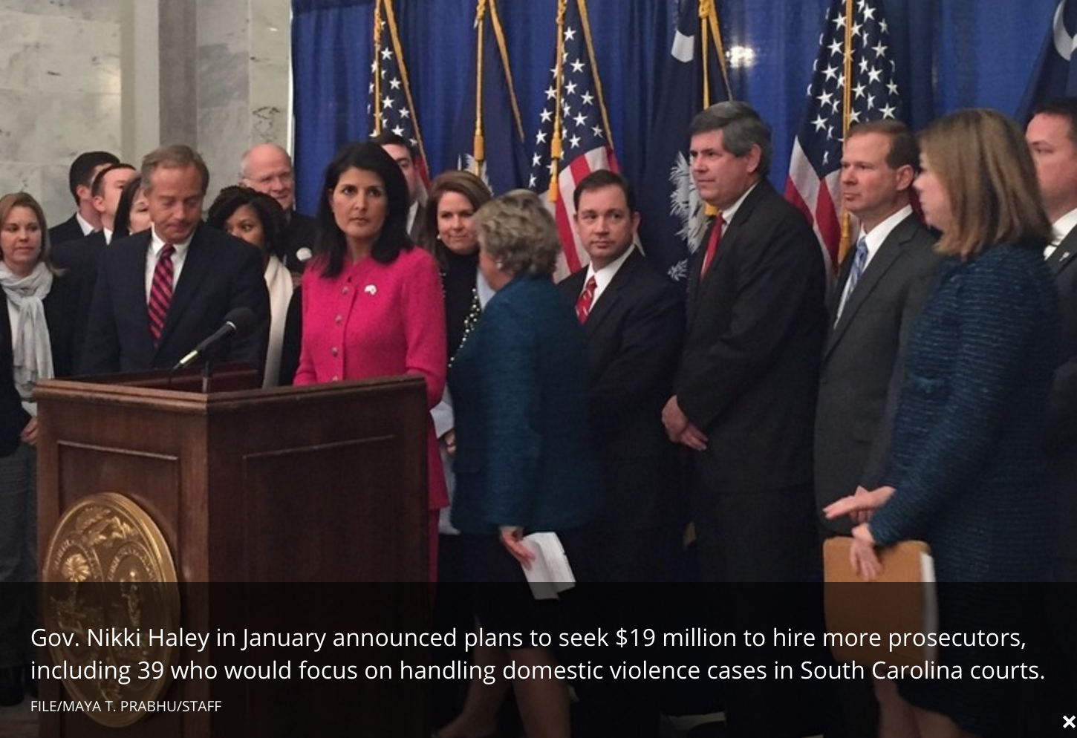
Post & Courier

Slide 20
Domestic Violence Reform Act, 2015
Clearer definitions
Degrees of violence
Stronger punishments.

Slide 21
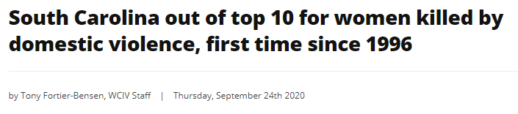
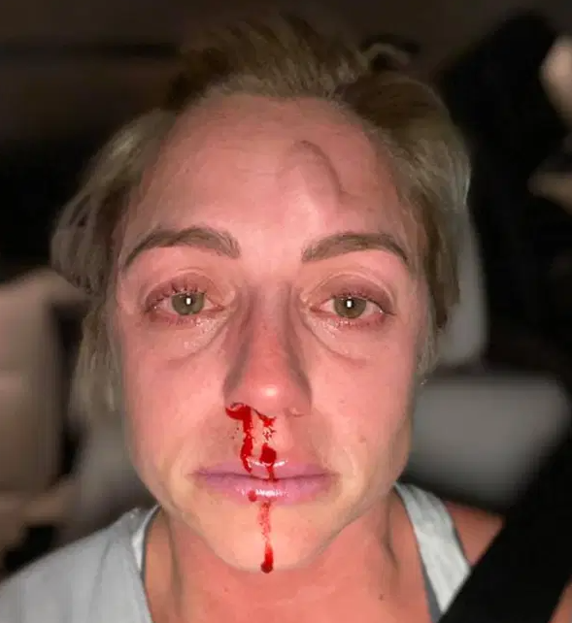

Slide 22
CRIMINAL DOMESTIC VIOLENCE COURT
Law enforcement
Judges
Prosecutors
Mental health professionals
Victim advocates
Goal: improve the safety for victims and hold offenders accountable.

