Slide 1
CHRONIC HYPERTENSIONWITH SUPERIMPOSED PE
Donna D. Johnson, MD

Slide 2
CHRONIC HYPERTENSION
HTN prior to pregnancy
>140/90 prior to 20 weeks

Slide 3
CHRONIC HYPERTENSION
20-50% may develop PE
75% with ESRD
Outcome worse with HTN + PE
ASA 81 mg after 12 weeks

Slide 4
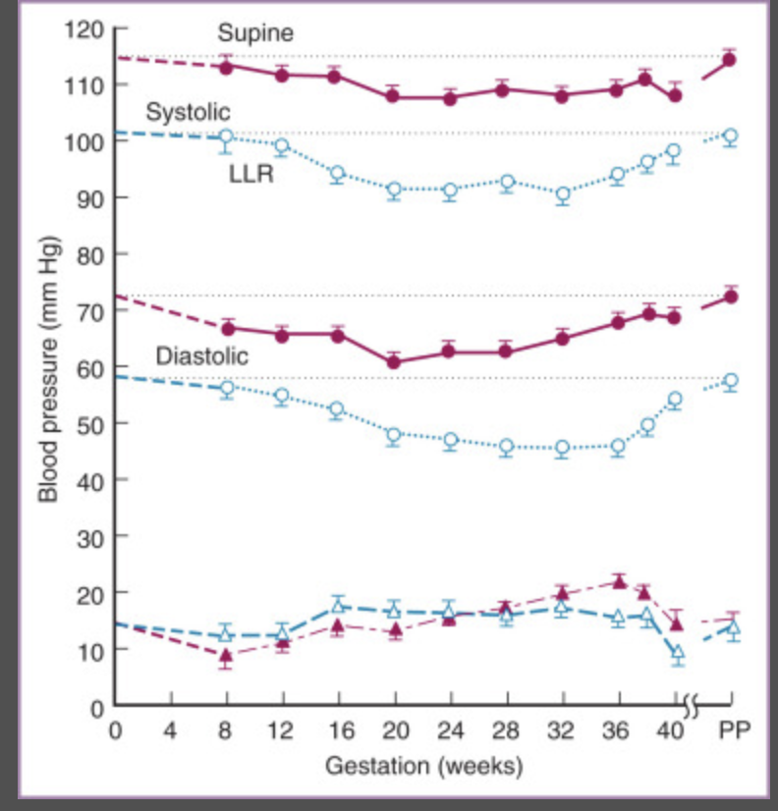
BLOOD PRESSURE CHANGES

Slide 5
PREGNANCY CHANGES
Creatinine ↓
Creatinine Clearance ↑
Proteinuria ↑
Uric Acid ↓
Liver enzymes →
Platelets →
CBC ↓ in second trimester

Slide 6
DIAGNOSISING SUPERIMPOSED PE
It is not easy
Often a diagnosis of exclusion

Slide 7
BLOOD PRESSURE
↑ 28 weeks: 160/110
If not on meds: start
If on low dose of one med: ↑
If maxed out on a med: + second
Check BP at home
See the patient often (2-3 days)
Warn patient re: symptoms
Give steroids
Consider antenatal testing

Slide 8
PROTEINURIA
No Baseline Proteinuria: P/C ratio
Use P/C ratio to determine ↑
Baseline Proteinuria: 24 hour protein and Creatinine clearance
If protein ↑’s
Protein ↑ and creatinine clearance ↑: Normal physiology
Protein ↑ and creatinine clearance ↓: Superimposed PE

Slide 9
LABS
↑ Creatinine
↑ Uric acid
↓ Platelets
↑ LFT’s

Slide 10
SYMPTOMS
Uncontrolled headache
Blurred vision
Pulmonary Edema
RUQ pain
Vaginal bleeding
Contractions

Slide 11
DELIVERY
Uncontrolled HTN
Worsening renal function
HELLP
Symptoms
37 weeks

