Slide 1
Non-Invasive Prenatal Screening (NIPS) Part II Utilizing cffDNA technology for expanded aneuploidy screening and single gene disorders
Jessica M. Fairey, MS, CGC
Assistant Director, Clinical Assistant Professor
USC Genetic Counseling Program
Prenatal & Adult Genetic Counseling Services
Prisma Health Department of ObGyn
Notes:
Today we will talk about additional uses for cell free fetal DNA technology.

Slide 2
Conflict of Interest Statement
No conflicts to declare
Discussion of labs is based on personal clinical experience

Slide 3
Noninvasive Prenatal Screening (NIPS)
Most sensitive and specific screening test for common aneuploidies (trisomies 13,18,21)
Lowest false positive rate
Only screening test for fetal sex aneuploidies
Early gestational age allows for optimal patient decision making
Risk assessment – NOT diagnostic
Dependent upon fetal fraction
Notes:
To review, READ SLIDE
As a reminder, NIPS is recommended by ACOG, ACMG and International Prenatal Diagnosis Society to be offered to all women in pregnancy regardless of their aneuploidy risk.
Because placental cells undergoing programed cell death are needed for analysis, this screening test relies on the amount of this fetal fraction within the maternal sample.

Slide 4
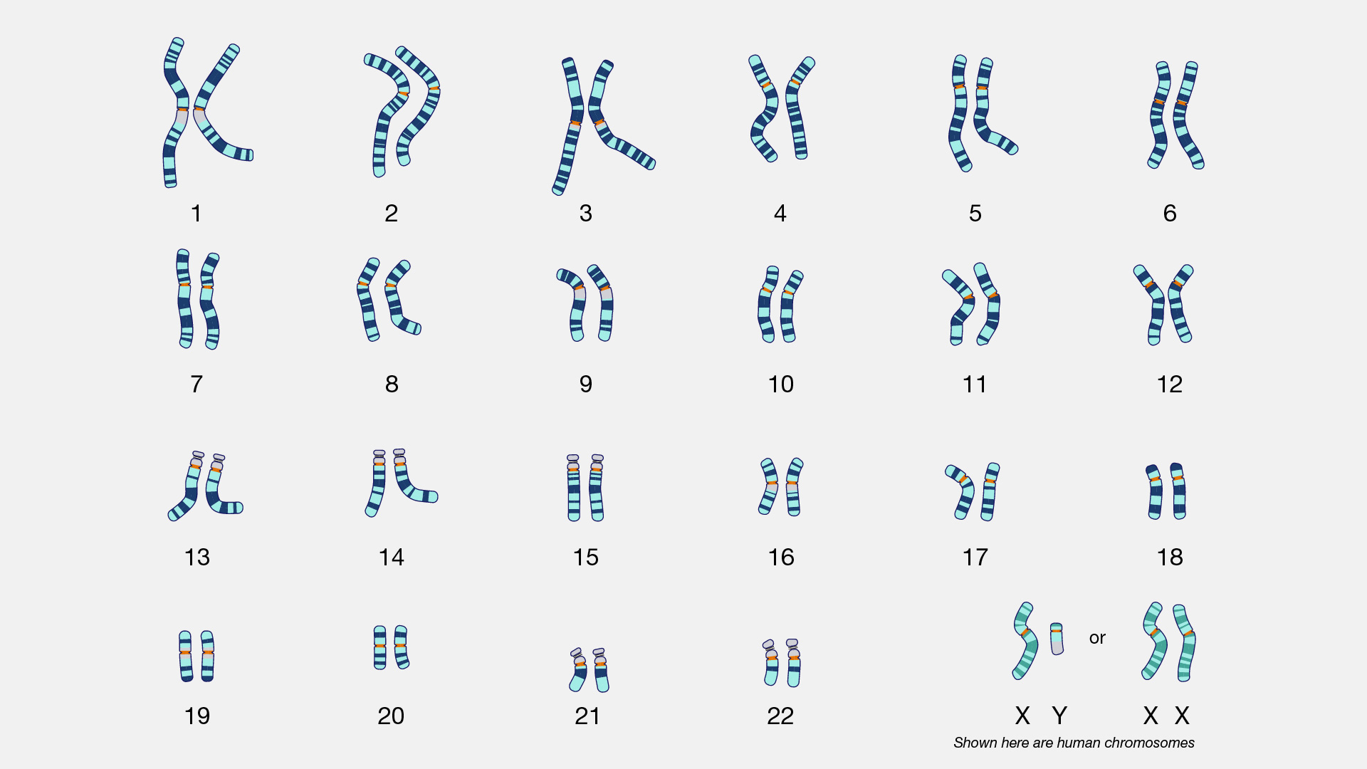
Notes:
In the previous talk, we reviewed NIPS for common aneuploidies including trisomies 21, 13, 18 and sex chromosome abnormalities.
Why does it matter if a chromosome is in excess? Because each chromosome has hundreds of genes and extra material or missing material can disrupt fetal development.

Slide 5
Copy Number Variants
Notes:
When we look closer at a chromosome, there are areas that are gene rich. The chromosome pair in the middle shows regions of genes labeled A through D. When congenital anomalies are detected, we should consider if pieces of a chromosome may also be deleted or duplicated. You can see on the left that one pair of the chromosomes has a deletion of region C and the chromosome on the right has a duplication of region C. We call these copy number variants. You may also hear them called microdeletions or microduplications. The best way to test for copy number variants is through a microarray analysis which is performed on a diagnostic sample such as chorionic villi, amniocytes or peripheral blood.

Slide 6
Expanded NIPS
MaterniT Genome (LabCorp)
CONSIDERATIONS
Screens for 23 WHOLE chromosome abnormalities
Screens for copy number variants (CNVs) > 7 Mb
NOT diagnostic
Reflex option
Nonspecific findings on ultrasound for patients not undergoing prenatal diagnosis
Parental translocation, LARGE ENOUGH, to be detected
Highly anxious families
Notes:
Not all of our patients are comfortable with prenatal diagnostic testing so there is another screening test that allows for additional analysis.
MatenriTGenome can screen for all 23 whole chromosome abnormalities, implying that it can detect a trisomy or monosomy with any chromosome. Additionally it can detect LARGE duplications or deletions of material. Microarray analysis would still be needed to microduplications or deletions.
This is not a diagnostic test and there is a reflex option meaning that if a provider orders a routine NIPS from LabCorp and ultrasound identifies anomalies later in pregnancy, labcorp can screen the retained sample for other aneuploidy and CNVs.

Slide 7
Expanded NIPS Limitations
Does not interrogate ALL chromosome material
Risk assessment is limited to LARGE deletions/duplications of chromosome material
Does not screen for NTDs
Offer MSAFP only after 15w
Results may represent chromosomal changes from…
Mother
Placental mosaicism
Fetal mosaicism
Vanished twin
Residual Risk
PPV difficult to calculate due to low prevalence of CNVs
Notes:
The limitations are similar to standard NIPS. READ SLIDE

Slide 8
Birth Defect Etiologies
97%
Normal
40–60%
3%
Defects
20–25%
10–15%
8–12%
2–10%
Adapted from Stevenson, RE and Hall, J. Human Malformations and Related Anomalies, 2nd ed. Oxford University Press, Oxford, 2006
Notes:
We are going to now move away from chromosome abnormalities to focus on single gene disorders that account for up to 10% of birth defects.

Slide 9
Notes:
Here we have another karyptype but rather than focusing on an entire extra or missing chromosome or even a region of the chromosome like we showed with the copy number variant, we are instead going to hone into the gene level.
As mentioned before, each chromosome has hundreds of genes. Chromosomes 1 to 22 are known as autosomes where as the X and Y are the sex chromosomes. Because our chromosomes are all in pairs, we have two copies of every gene, one from our mom and one from our dad. Ideally, both of our genes are working and do not have a mutation or variant that would prevent the body from reading the genetic instruction. When this happens, disease occurs.

Slide 10
Autosomal Dominant Inheritance
Genomics Education Programme
Notes:
To provide context for the rest of our talk, I want to review the most common inheritance patterns for single gene or monogenic disorders.
When a genetic change resides on an autosome, the disease theoretically affects males and females equally.
With an autosomal dominant pattern, only one gene is required to have a genetic change for the disease to manifest and an individual to be affected. When a parent is affected with an autosomal dominant condition, each of their children have a 50% chance of inheriting that genetic change since it is a flip of a coin which chromosome is passed down in the egg or sperm.

Slide 11
Autosomal Recessive Inheritance
Genomics Education Programme
Notes:
With autosomal recessive inheritance, both copies of a gene must be changed or mutated for an individual to manifest symptoms and be affected. In order for this to happen, that individual had to inherit a genetic change from each parent. In other words, both of their parents were carriers for the genetic disease.
When an individual is a carrier, they are unaffected b/c their working gene copy is enough to keep them healthy. For two carrier parents, they have a 25% chance of having an affected child. There is a ½ chance the mother will pass on her chromosome with the genetic change and a ½ chance the father will do the same, giving the 1 in 4 or 25% risk for disease in offspring.

Slide 12
X-linked Inheritance

Slide 13
Single gene NIPS
Vistara (Natera)
Considerations
25 autosomal dominant conditions
Sensitivity/specificity is gene specific
Increased incidence of de novo mutations in curated gene list
Select conditions with third trimester ultrasound findings, nonspecific findings or no findings
Advanced paternal age
Paternal family history
Variable expression for some conditions (i.e. Noonan)
Mother cannot be affected
Late gestation ultrasound findings for patients not undergoing prenatal diagnosis
Craniosynostoses
Skeletal dysplasias
Notes:
Natera has a cell free fetal DNA option to screen for a group of autosomal dominant conditions. The performance of the screening is dependent on the specific gene.
The gene list was curated based on a few factors – the rate of de novo or new mutations that occur in the gene. This is when there is no family history but a child is born with a single gene disorder that occurred as a new mutation at conception. Many of these conditions also present with later onset ultrasound findings, usually third trimester, or they may have nonspecific or absent findings.
Considerations for using this test would be for advanced paternal age. APA is defined as a male over 45. The risk to a pregnancy is for single gene disorders due to replication errors in spermatogenesis. Because the genes on this panel are large, they have more room for error, therefore are increased approximately 2 fold for fathers over 45. These conditions are rare so a 2 fold increase is still less than a 1% risk.
Other considerations would be if there is a paternal family history – some of these conditions such as Noonan syndrome can display variable expression. Remember the mother cannot be affected because this may cause a false positive result.
Lastly, if there are late gestation anomalies and the patient is not pursuing prenatal diagnosis, then you may consider Vistara. 1/3 of the conditions are those involved in craniosynostoses or premature close of cranial sutures, and skeletal dysplasias, some of which are lethal like thanatophoric dysplasia.

Slide 14
Single gene NIPS
Unity (BillionToOne)
Considerations
4 autosomal recessive genes
HBB, HBA, CFTR, SMN1
Carrier screening w/ reflex to single gene NIPS
Paternal sample not needed for fetal risk assessment
Will not predict carrier status of fetus
Patient is known carrier for CF, SMA, hemoglobinopathy and partner is unavailable
At risk couple not undergoing prenatal diagnosis
Residual risk may be difficult to interpret – provides increased or reduced risk for recessive condition
Notes:
Another single gene NIPS test focuses on autosomal recessive conditions and screens 4 genes.
Variants in the HBB gene cause sickle cell disease, beta thalassemia and other betaglobinopathies.
Variants in HBA cause alpha thalassemia
Variants in CFTR lead to cystic fibrosis and variants in SMN1 lead to spinal muscular atrophy.
The test is set up in 2 steps. First the mother herself has carrier screening performed to see if she is a carrier for any of these disorders. If she is found to be a carrier, the test then reflexes to the second step which is a single gene NIPS for fetal risk assessment.
A paternal sample is not needed.
This test will only provide a risk assessment for an affected fetus – it will not predict carrier status.

Slide 15
Genetic Carrier Screening
Carrier is an individual heterozygous for a pathogenic or likely pathogenic variant in an autosomal recessive or X linked gene
Carriers for autosomal recessive conditions typically do not manifest
Carriers for X linked conditions may manifest differently than offspring
Preconception screening is ideal
Consanguineous couples are at increased risk for autosomal recessive conditions
Carrier screening does not report variants of uncertain significance.
Notes:
A little bit about carrier screening…
Carrier is an individual heterozygous for a pathogenic or likely pathogenic variant in an autosomal recessive or X linked gene
A pathogenic or likely pathogenic variant are mutations within a gene that are known to cause disease.
READ REST OF SLIDE – carriers do not…
A variant of uncertain significance is a mutation within a gene that does not have enough evidence to classify as benign or pathogenic.

Slide 16
ACOG Committee Opinion 690, March 2017, Reaffirmed 2020
Ethnic-specific, panethnic, and larger panels are acceptable strategies
Consider carrier frequencies for guidance
All patients should be offered screening for CF, SMA and hemoglobinopathies
For carriers, reproductive partners should be offered screening
Consider testing strategy / referral to genetic counseling
Genetic counseling referral:
Consanguineous couples
Carrier couples
Family history of genetic disorders
CBC + hemoglobin electrophoresis to screen for thalassemias
Negative carrier screening reduces the chance to be a carrier
Risk cannot be eliminated
Notes:
ACOG is not pointed in their recommendation of a panel size but encourages clinics to develop their own consistent protocol with panel size.
When considering a panel size, consider the carrier frequencies of the included conditions. Maybe your clinic feels that a frequency of greater than 1 in 100 is appropriate. Then you may be screening for ~30 conditions. Whereas if you cast a wider net, an appropriate screen may be a 120 disease panel.
Regardless of panel size, all patients should AT LEAST be offered screening for CF, SMA and hemoglobinopathies. This is based on the increased carrier frequencies for these diseases in the population.
Any negative carrier screening will reduce a patient’s chance but won’t eliminate it. And anyone who is found to be a carrier, the reproductive partner should be offered screening. Again, considering the testing strategy and a referral to genetic counseling is warranted.
For any patients who are consanguineous, are at risk or have a family history of a genetic disorder, should be referred for genetic counseling prior to carrier screening selection.

Slide 17
Case Presentation
Notes:
I have a case to highlight the nuances and importance of carrier screening

Slide 18
Cystic Fibrosis Case Utilizing sgNIPS
Initial Consult:
33 year old G3P1011 – first child diagnosed with cystic fibrosis on NBS
Elevated IRT → molecular analysis → positive sweat test
“Negative family history”
Carrier screening performed in 2019 to confirm carrier status following son’s diagnosis

Slide 19
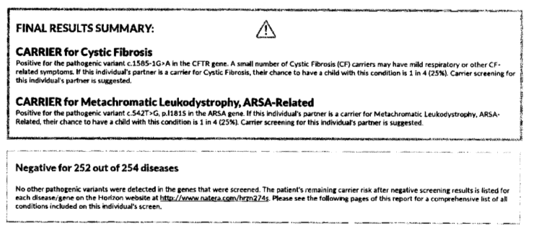
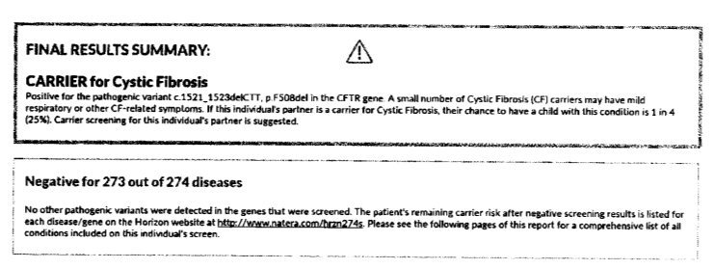
Father’s carrier screen result
Mother’s carrier screen result
No other pathogenic variants were detected in the genes that were screened.
Notes:
Based on this result, the couple understood their recurrence risk to be 25% for all pregnancies.

Slide 20
Current pregnancy: Patient elects Unity Screen
1) Carrier Screening: Patient was found to be COMPOUND HETEROZYGOUS
Known pathogenic F508del
and a newly identified likely pathogenic variant:
c.2657+2_2657+3insA
2) Reflex to sgNIPS: Reduced Fetal Risk

Slide 21
Through linkage analysis, determined that the mother’s variants are on two separate chromosomes (trans), confirming a molecular diagnosis of Cystic Fibrosis – recurrence risk adjusted from 25% to 50% !

Slide 22
Follow Up
Why was this missed on carrier screening performed on the patient in 2019?
Carrier screening does not report variants of uncertain significance on carrier screening panels → Requested reanalysis of carrier screening → Variant had been reclassified within the past year → Confirmed to now be reported
What does this now mean for the patient?

