Slide 1
Postpartum Hemorrhage
Assessing etiology and management
Berry A. Campbell, MD

Slide 2
Postpartum Hemorrhage Management
Determine etiology
Maintain hemodynamic stability
Treat underlying cause

Slide 4
Postpartum Hemorrhage
Assess pelvic injury
Sweep uterus, US
Coagulation labs

Slide 5
Postpartum Hemorrhage
Atony
Uterotonics
Tamponade
Surgical
Embolization
Hysterectomy

Slide 9
The Bakri SOS Tamponade Balloon
Courtesy: Cook Women’s Health

Slide 12
Surgical
Vascular ligation
O’Leary
Utero-ovarian
Hypogastric artery ligation

Slide 13
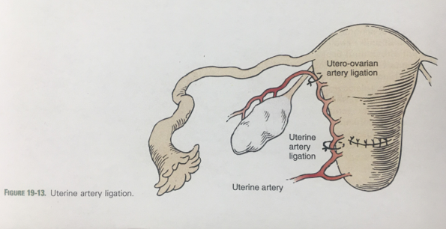
Uterine Artery Ligation

Slide 14
B-Lynch Compression Suture

Slide 15
Embolization
Mainly with slow persistent bleeding
Wishes to retain fertility
Failed other less invasive therapy

Slide 16
Uterine Inversion

Slide 17
We will discuss Assessment of Blood Loss and Replacement at the next session!

Slide 18
To Request a Copy of today’s Didactic Video Presentation Contact Rachel Grater, Program Coordinator grater@musc.edu

Slide 19
Project ECHO South Carolina Pregnancy Wellness
Visit Our Website: https://sctelehealth.org/services/pregnancy-wellness
Didactic Slide Sets Available on Website
1st & 3rd Wednesday/Month Postpartum Hemorrhage 12:15 pm – 1:00 pm
Date | Topic
5/19/21 | Assessing blood loss and management

Slide 20
Tele-Mentoring Programs in South Carolina
Project ECHO Opioid Use Disorders
Medical Director
Dr. Karen Hartwell, MUSC
Program Coordinator: Rachel Grater, grater@musc.edu
Website: www.scmataccess.org
1st and 3rd Friday of each month
12-1 pm
Project ECHO Pregnancy Wellness
Co-Medical Directors
Dr. Berry Campbell, USC and Dr. Donna Johnson, MUSC
Program Coordinator: Rachel Grater, grater@musc.edu
Website: www.pregnancywellnesssc.com
1st and 3rd Wednesday of each month
12:15-1 pm
Southeast Viral Hepatitis Interactive Case Conference
Medical Director
Dr. Divya Ahuja, USC
Program Coordinator: Adrena Harrison, adrena.harrison@uscmed.sc.edu
Website: http://schivtc.med.sc.edu/
1st and 3rd Wednesday of each month 12-1pm
4th Wednesday of each month 1-2pm
Project ECHO Peer Recovery Support Specialists
Co-Directors
Dr. Karen Hartwell, MUSC and Mike Malone, CPSS, NCPRSS, FAVOR Greenville
Program Coordinator: Rachel Grater, grater@musc.edu
2nd and 4th Tuesday of each month
12-1 pm

