Slide 1
VTE Risks in Pregnancy:
Who needs prophylaxis?
Berry Campbell, MD
Project ECHO-Women’s Wellness
Prisma Health Midlands/UofSC School of Medicine Columbia

Slide 2
Learning Objectives
Why does pregnancy increase the risk for VTE?
When is the greatest risk for VTE associated with pregnancy?
What are the risk factors for VTE in pregnancy and what are the 2 most important?
What is the best way to assess whether a person needs medical thromboprophylaxis?

Slide 3
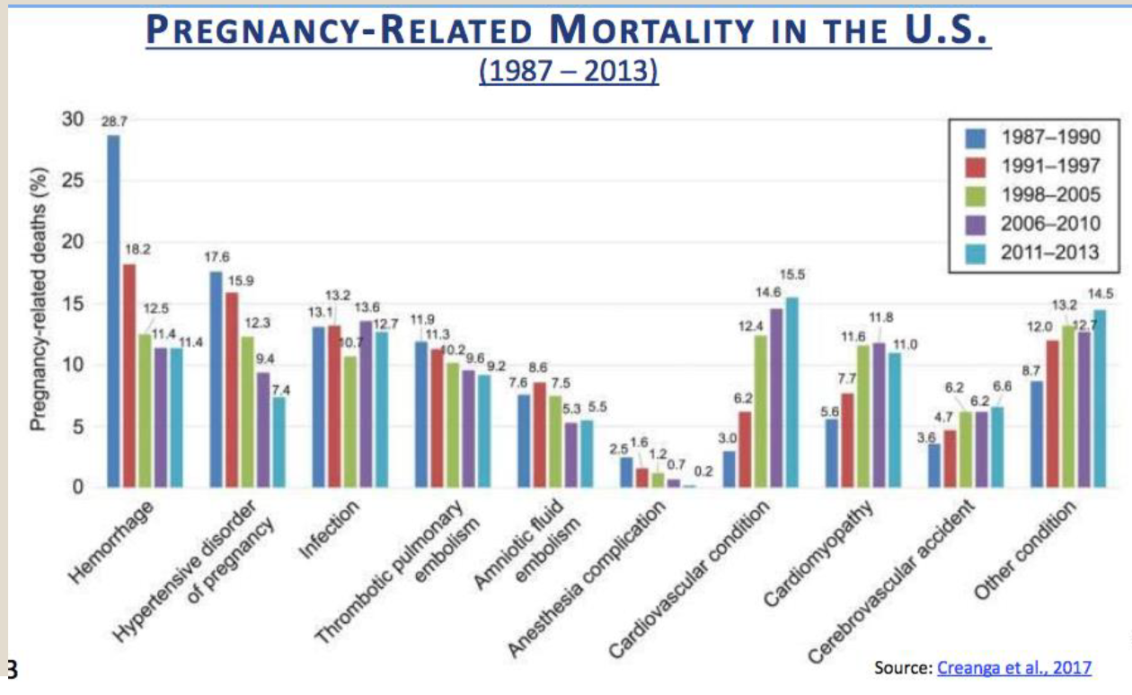
Venous Thromboembolism

Slide 4
Venous Thromboembolism
Five-fold increased risk pregnancy/postpartum (1-2/1000 overall)
Accounts for near 10% maternal mortality
Deep venous thrombosis 80%
Pulmonary embolism 20%
Half during pregnancy, half post delivery
Risk per day highest 2 weeks pp

Slide 5
VTE
Risk due to physical (anatomic) and physiologic reasons
Compression of IVC and pelvic veins → venous stasis
Decreased mobility
Hypercoagulability

Slide 6
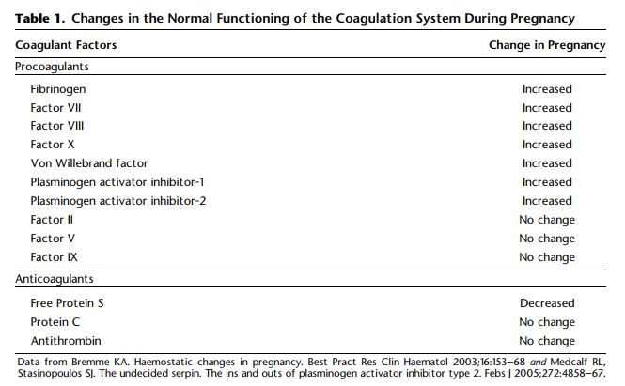
Vol. 132, No. 1, July 2018 Obstetrics & Gynecology

Slide 7
Risk factors
Given overall low absolute risk, risk stratification needed
Threshold for thromboprophylaxis recommendation is lower pp due to the high risk per day and shorter duration of risk

Slide 8
Risk factors
Prior VTE 2-11% recurrence risk (odds ratio 24.8)
Inherited thrombophilia found in 20-50% pregnancy related VTE (aOR depends on specific thrombophilia ie: APS aOR 13). Table 3 ACOG Bulletin 196
Obesity aOR 4.4 (DVT) and 14.9 (PE)
AMA aOR 1.6
Immobility/long travel > 4 hours aOR 7.7-10.8
Others: hosp admission, smoking, HTN, preeclampsia, sickle cell, multiples, cesarean section (aOR 3.6), chorioamnionotis, pp hemorrhage

Slide 9
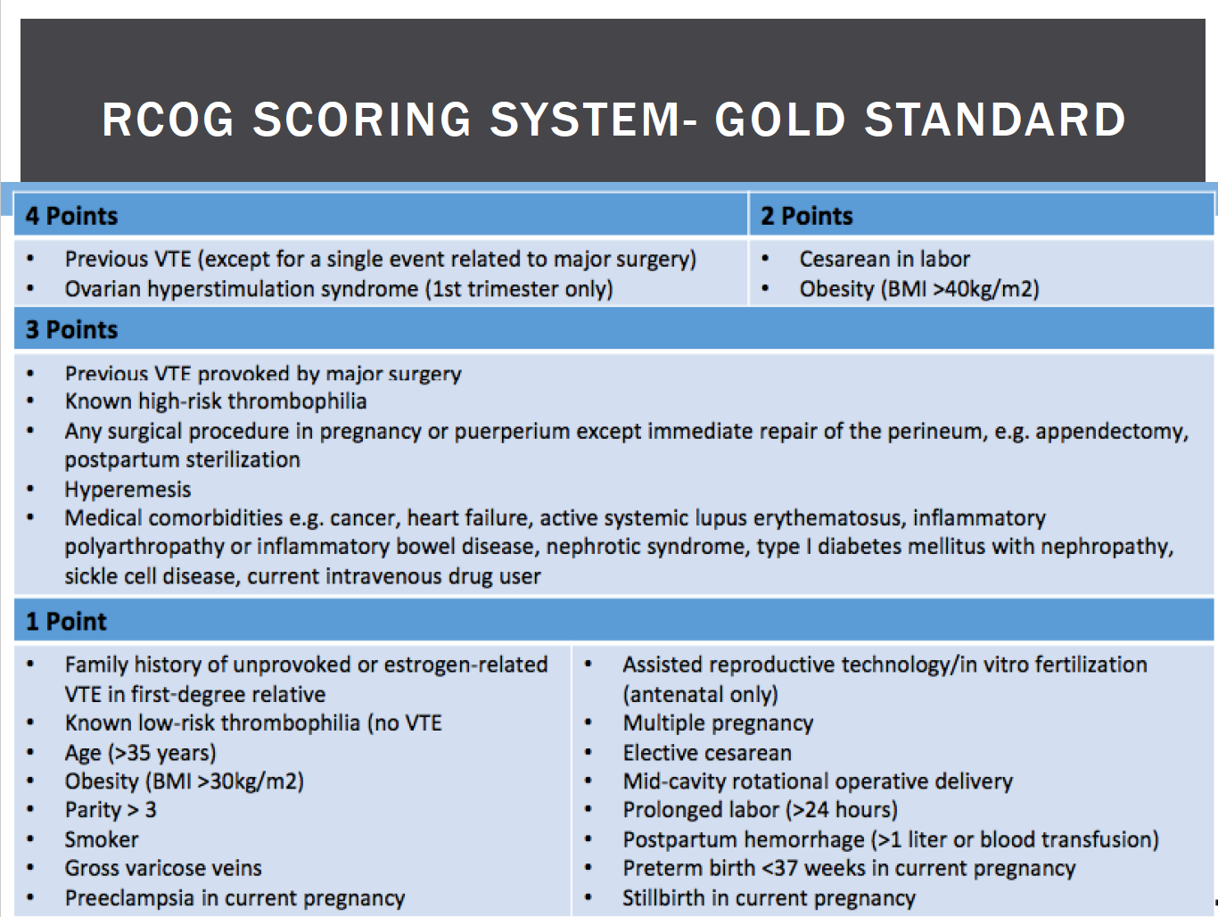
BCOG.org

Slide 10
High risk thrombophilias
F5LM homozygous
Prothrombin gene G20210 mutation homozygous
Heterozygous for both the above
Antithrombin deficiency

Slide 11
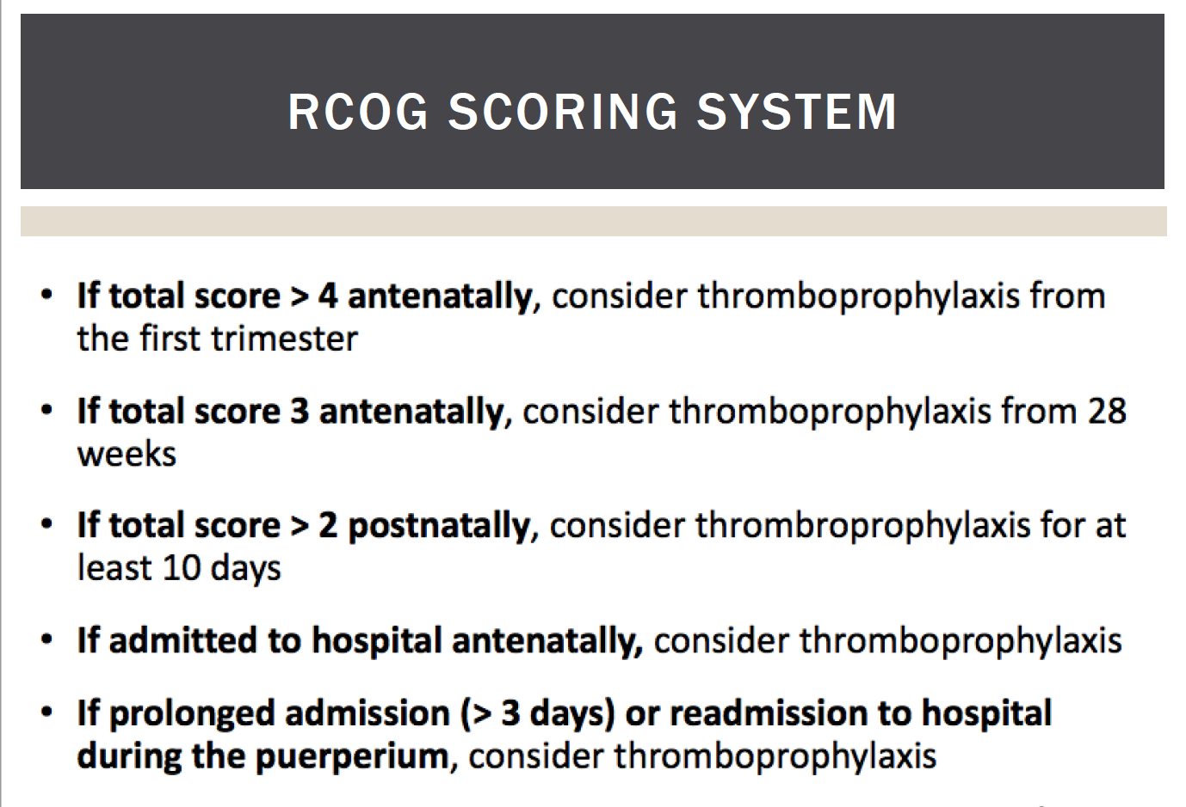
BCOG.org

Slide 12
Risk factor counseling
Pre-pregnancy counseling is vital
First trimester VTE risk is significant!
Identify risk factors, preventive interventions become an opportunity to impact outcome

Slide 13
Pregnancy increases the risk of VTE due to:
A-mechanical compression
B-estrogen increases
C-impaired mobility
D-all the above

Slide 14
The risk factor with the greatest risk of VTE in pregnancy is:
A- Sickle cell disease
B- Preeclampsia
C- Obesity
D- prior VTE

Slide 15
Learning Objectives
Why does pregnancy increase the risk for VTE?
When is the greatest risk for VTE associated with pregnancy?
What are the risk factors for VTE in pregnancy and what are the 2 most important?
What is the best way to assess whether a person needs medical thromboprophylaxis?

Slide 16
Future discussions
Types of thromboprophylaxis
Dosing strategies of medical thromboprophylaxis
When to suggest mechanical and/or medical thromboprophylaxis
Diagnosing VTE in pregnancy

