Slide 1
Antepartum and Postpartum Hemorrhage
Assessing Risks and Prevention
Berry A. Campbell, MD

Slide 2
OB hemorrhage is the leading cause of an OB admission to ICU
Responsible for up to 25% of all pregnancy related deaths
Hemorrhage that leads to transfusion is leading cause of severe maternal morbidity in the US (followed by DIC)
Rate of pp hemorrhage increased 26% from 1994 to 2006 (atony)
Mortality has DECREASED from pp hemorrhage since 1990 (accounts for slightly >10% of maternal mortality in the US)

Slide 3
Normal Physiology
Plasma volume increase by 50%
Red blood cell increase by 30%
Cardiac output increase by 50%
SVR falls progressively
Increase fibrinogen, II, VII, VIII, IX and X

Slide 4
Physiologic Adaptation to Hemorrhage
10% loss → vasoconstriction
20% loss → ↓ BP, ↓ CO
> 25% loss → cardiogenic shock

Slide 5
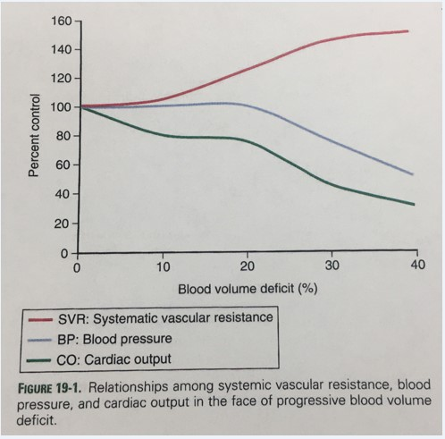
Adaptation to Hemorrhage

Slide 6
Physiologic Responses by Hemorrhage Class
Class
Loss (%)
Response
Dizziness, palpitations, minimal BP change
Tachy, tachypneic, weak, sweatiness, narrow pp
Significant tachy, tachypnea, restless, pallor, cool extremities
Air-hunger, cardiogenic shock, oliguria
1
2
3
4
1000 ml (15%)
1500 ml (20-25%)
2000 ml (30-35%)
>2500 ml (>35%)

Slide 7
Postpartum Hemorrhage
Definition
Cumulative Blood Loss > 1000 mℓ first 24 hrs
OR
Blood loss associated with signs/symptoms of hypovolemia first 24 hrs

Slide 8
Postpartum Hemorrhage
Signs/Symptoms often do not present until late
Hypotension and Tachycardia →
usually ≥ 25% (≥ 1500 mℓ) lost

Slide 9
Postpartum Hemorrhage
Sequelae
Adult respiratory distress
Shock
DIC
Acute renal failure
Loss of fertility
Pituitary necrosis (Sheehan Syn)

Slide 10
Postpartum Hemorrhage
Increasing incidence
Mortality decreasing since 1980’s
Accounted for slightly > 10% maternal mortality in 2009

Slide 11
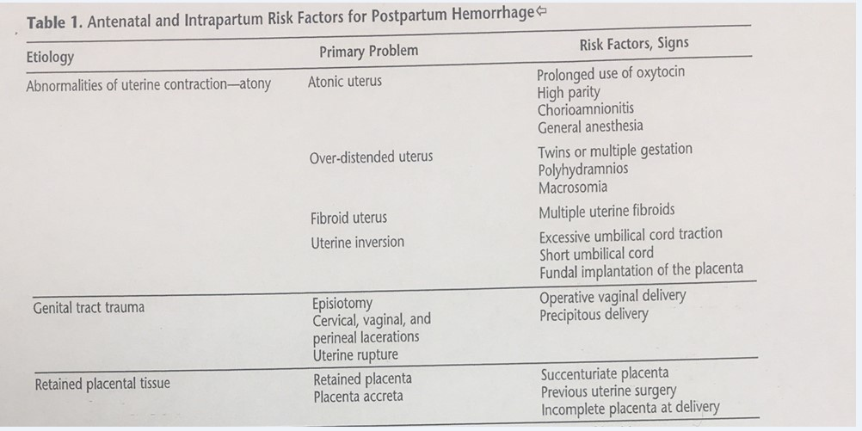
Postpartum Hemorrhage
Risk Factors

Slide 12
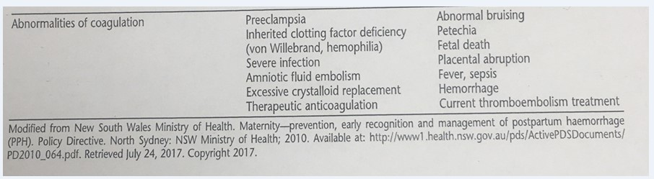
Postpartum Hemorrhage
Risk Factors

Slide 13
Prevention
Uterotonics after all births
Uterine massage
Heightened awareness and aggressive management
Develop your own protocol
Risk assessment: identifies 60-80%

Slide 14
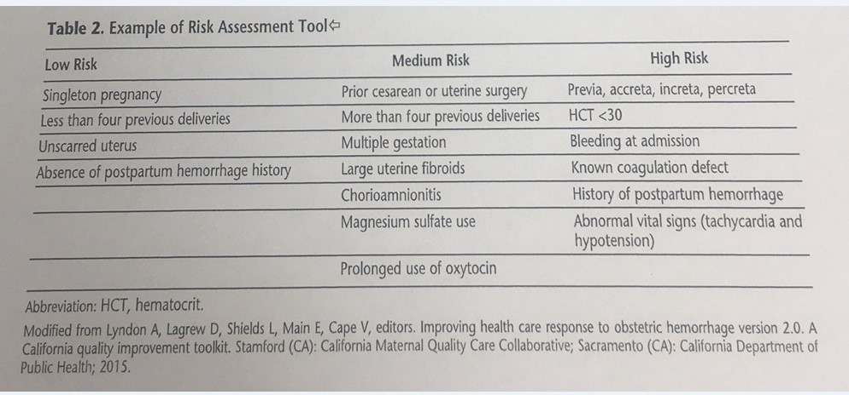
Postpartum Hemorrhage
Risk Assessment Tool

Slide 15
Postpartum Hemorrhage
Prevention
Active management 3rd stage
  Oxytocin
  Uterine massage
  UC traction

Slide 16
Antepartum Hemorrhage
Abruptio Placenta: 1:100
Placenta Previa: 1:200

Slide 17
Project ECHO South Carolina Pregnancy Wellness
Visit Our Website: https://sctelehealth.org/services/pregnancy-wellness
1st & 3rd Wednesday/Month Postpartum Hemorrhage 12:15 pm – 1:00 pm
Date | Topic
5/5/21 | Assessing etiology and management
5/19/21 | Assessing blood loss and management

Slide 18
Tele-Mentoring Programs in South Carolina
Project ECHO Opioid Use Disorders
Medical Director
Dr. Karen Hartwell, MUSC
Program Coordinator: Rachel Grater, grater@musc.edu
Website: www.scmataccess.org
1st and 3rd Friday of each month
12-1 pm
Project ECHO Pregnancy Wellness
Co-Medical Directors
Dr. Berry Campbell, USC and Dr. Donna Johnson, MUSC
Program Coordinator: Rachel Grater, grater@musc.edu
Website: www.pregnancywellnesssc.com
1st and 3rd Wednesday of each month
12:15-1 pm
Southeast Viral Hepatitis Interactive Case Conference
Medical Director
Dr. Divya Ahuja, USC
Program Coordinator: Adrena Harrison, adrena.harrison@uscmed.sc.edu
Website: http://schivtc.med.sc.edu/
1st and 3rd Wednesday of each month 12-1pm
4th Wednesday of each month 1-2pm
Project ECHO Peer Recovery Support Specialists
Co-Directors
Dr. Karen Hartwell, MUSC and Mike Malone, CPSS, NCPRSS, FAVOR Greenville
Program Coordinator: Rachel Grater, grater@musc.edu
2nd and 4th Tuesday of each month
12-1 pm

