Slide 1
Chronic Hypertension
Richard D. Adams, MD, FACOG
Maternal Fetal Medicine
USC School of Medicine
Prisma Health Midlands
Wednesday October 18, 2023

Slide 2
Case Presentation
Ms. Smith-Jones presents to the office for IUD removal. She is a 35-year-old G1 P0-1-0-1 with a history of chronic hypertension diagnosed 9 years ago. She and her husband desire to have another child.
OBHx – G1: 29 week C-section secondary to preeclampsia with severe features, fetal growth restriction, and abnormal umbilical artery Dopplers 6 years ago
PMH – Chronic hypertension, Class III Obesity (BMI 42), polycystic kidney disease
PSH – C-section, rhinoplasty
Meds – Lisinopril/HCTZ: 20/12.5 daily, Amlodipine: 5 mg daily

Slide 3
Chronic Hypertension
Globally, the prevalence of hypertension in adults is very high
Essential Hypertension most likely cause of hypertension predating pregnancy in 86 – 89% of cases
Risk factors include: advancing age, Obesity, Family History, race, high sodium diet, excess alcohol consumption, inactive lifestyle, poor social situation
Secondary Hypertension results as a sequelae of another factor
Renal Disease (CKD, Polycystic disease, etc)
Vascular Disease (atherosclerosis, vascular scleroderma, Takyasu Arteritis, etc)
Endocrine Disease (Cushing’s Syndrome, Hyperthyroid)
Tumor such as pheochromocytoma
Obstructive sleep apnea
Illicit drug use (amphetamine, cocaine)
Rx & non-Rx drugs (OCP, chronic NSAID use, corticosteroids, phenylephrine, cyclosporine, tacrolimus, certain antidepressants, certain atypical antiphsychotics, etc)

Slide 4
Chronic Hypertension
The prevalence of chronic hypertension in pregnancy in the United States is estimated to be as high as 3%, and has been increasing over time.
Increase attributed to increased prevalence of obesity, metabolic syndrome, and delayed childbearing (AMA)
Chronic Hypertension in Pregnancy: Hypertension diagnosed either prior to pregnancy or prior to 20 weeks of gestation
Traditionally diagnosed as SBP≥ 140 and/or DBP ≥ 90
2 readings at least 4 hours apart unless faced with Severe Hypertension

Slide 5
Chronic Hypertension
In 2017, the American College of Cardiology and American Heart Association (ACC/AHA) changed the criteria for classification of hypertension in adults
Classification:
Category 1: Normal (systolic blood pressure less than 120 mm Hg and diastolic blood pressure less than 80 mm Hg)
Category 2: Elevated (systolic blood pressure of 120–129 mm Hg and diastolic blood pressure less than 80 mm Hg)
Category 3: Stage 1 hypertension (systolic blood pressure of 130–139 mm Hg or diastolic blood pressure of 80–89 mm Hg)
Category 4: Stage 2 hypertension (systolic blood pressure of 140 mm Hg or more or diastolic blood pressure of 90 mm Hg or more).
If there is a disparity in category between SBP & DPB, the HIGHER VALUE will determine the category
Recommendations to initiate antihypertensive therapy for Category 3 (Stage 1 hypertension) with 1 or more additional findings:
Known cardiac disease, Type I or II Diabetes, chronic kidney disease, Age 65 or greater, etc

Slide 6
Chronic Hypertension
Establishing a diagnosis of chronic hypertension in pregnancy may not be straightforward
In many otherwise health young women, blood pressures may not be known
Normal pregnancy physiology may mask previously undiagnosed chronic hypertension

Slide 7
Pregnancy Physiology
SBP & DBP fall early in pregnancy
Approx. 30% decrease in Systemic Vascular Resistance occurs early
May generate up to 10% reduction in BP as early as 7 – 8 weeks
DBP may decrease by up to 20 mm Hg (greater than SBP reduction)
Nadir between 16 – 22 weeks
Thus, Normal pregnancy physiology may mask previously undiagnosed chronic hypertension

Slide 8
Chronic Hypertension in Pregnancy
BP levels generally return to “normal” in the 3rd trimester
Thus, chronic hypertension often labeled as “Gestational Hypertension”
Approx. 11% of women with CHTN have baseline proteinuria (>300 mg/24 hrs)
Therefore, may be misdiagnosed as Preeclampsia
True distinction between CHTN vs Preeclampsia spectrum may only be evident in retrospect
However, 20 – 50% of pregnant women with CHTN may develop superimposed Preeclampsia

Slide 9
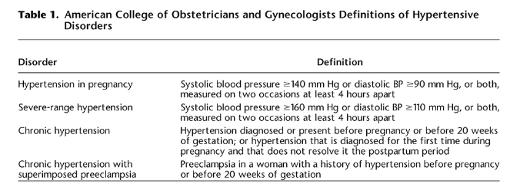
ACOG Definitions
ACOG PB 203; Jan 2019

Slide 10
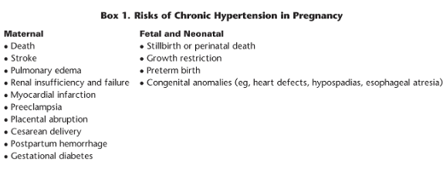
Risks of Chronic Hypertension in Pregnancy
ACOG PB 203; Jan 2019

Slide 11
Chronic Hypertension in Pregnancy
Baseline lab evaluation:
Complete blood count, Complete Metabolic Profile (electrolytes, LFTs, BUN/Cr)
Assessment for Proteinuria
Spot urine P:C ratio or 24-hour urine
P:C less than 0.15 safely indicates 24-hour urine less than 300 mg
Electrocardiogram +/- echocardiogram for women with longstanding CHTN
Poorly controlled HTN (more than 4 years) or longstanding HTN more likely to have hypertrophic changes, cardiomegaly, and ischemic heart disease

Slide 12
Chronic Hypertension in Pregnancy
Discontinue ACE-inhibitors and Angiotensin Receptor Blockers
Risk of fetal/neonatal renal impairment, oligohydramnios, and renal failure
Possible increased risk of miscarriage, stillbirth, and congenital anomalies:
Oligohydramnios, anuria, renal failure/dialysis, hypotension, pulmonary hypoplasia, Respiratory Distress, fetal growth restriction, limb defects, hypocalvaria, fetal/perinatal death

Slide 13
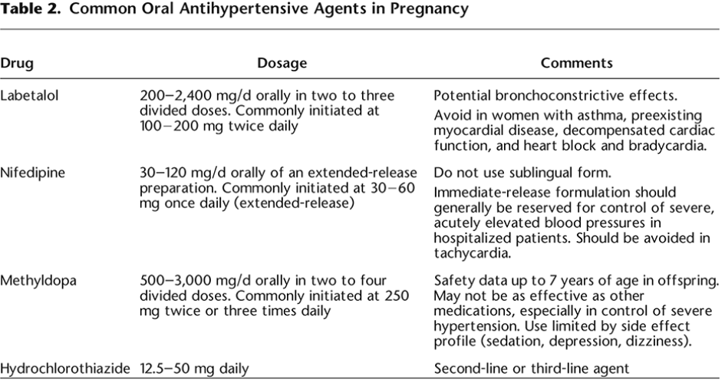
Chronic Hypertension in Pregnancy
ACOG PB 203; Jan 2019

Slide 14
Chronic Hypertension in Pregnancy
Use of Diuretics in Pregnancy
Thiazide diuretics – Not associated with fetal anomalies, but theoretical concern about interfering with pregnancy volume expansion
Would not initiate during pregnancy (without indication) but not unreasonable to continue if prescribed outside of pregnancy
Loop diuretics – Not routinely used in the antepartum setting. May be necessary in patients with significant cardiac dysfunction
Avoid if possible
Atenolol (beta-1 selective blocker) – growth restriction, lower placental neonatal weight
Propranolol (non-selective beta blocker ) – may promote uterine irritability due to blockage of beta-2 receptors reducing myometrial relaxation
Low Dose Aspirin (81 mg) should be initiated between 12 – 28 weeks (ideally prior to 16 weeks) for preeclampsia risk reduction

Slide 15
Chronic Hypertension in Pregnancy
CHAP Trial
Published in NEJM in April 2022
Multicenter RCT
Pregnant women with mild chronic hypertension enrolled prior to 23 weeks randomized to early treatment vs no treatment until severe-range BP (SBP≥160, DBP ≥105)
Findings: reduced risk of preeclampsia with severe features, preterm birth < 35 weeks, placental abruption, fetal/neonatal death)
Birthweight less than 10%ile similar in both groups
Reference:

Slide 16
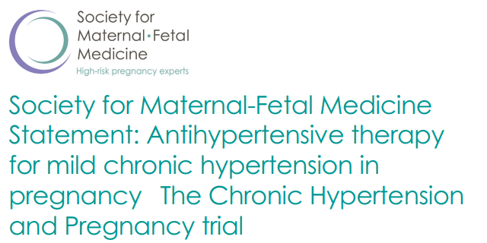

Slide 17
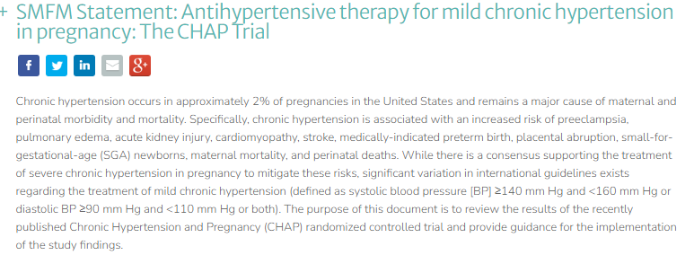
Chronic Hypertension in Pregnancy

Slide 18
Chronic Hypertension in Pregnancy
Discussion

