Slide 1
Chronic Hypertension with Superimposed Preeclampsia
Richard D. Adams, MD, FACOG
Maternal Fetal Medicine
USC School of Medicine
Prisma Health Midlands
Wednesday November 15, 2023

Slide 2
Chronic Hypertension
The prevalence of chronic hypertension in pregnancy in the United States is estimated to be as high as 3%, and has been increasing over time.
Increase attributed to increased prevalence of obesity, metabolic syndrome, and delayed childbearing (AMA)
Chronic Hypertension in Pregnancy: Hypertension diagnosed either prior to pregnancy or prior to 20 weeks of gestation
Traditionally diagnosed as SBP≥ 140 and/or DBP ≥ 90
2 readings at least 4 hours apart unless faced with Severe Hypertension

Slide 3
Chronic Hypertension
In 2017, the American College of Cardiology and American Heart Association (ACC/AHA) changed the criteria for classification of hypertension in adults
Classification:
Category 1: Normal (systolic blood pressure less than 120 mm Hg and diastolic blood pressure less than 80 mm Hg)
Category 2: Elevated (systolic blood pressure of 120–129 mm Hg and diastolic blood pressure less than 80 mm Hg)
Category 3: Stage 1 hypertension (systolic blood pressure of 130–139 mm Hg or diastolic blood pressure of 80–89 mm Hg)
Category 4: Stage 2 hypertension (systolic blood pressure of 140 mm Hg or more or diastolic blood pressure of 90 mm Hg or more).
If there is a disparity in category between SBP & DPB, the HIGHER VALUE will determine the category
Recommendations to initiate antihypertensive therapy for Category 3 (Stage 1 hypertension) with 1 or more additional findings:
Known cardiac disease, Type I or II Diabetes, chronic kidney disease, Age 65 or greater, etc

Slide 4
Chronic Hypertension
Establishing a diagnosis of chronic hypertension in pregnancy may not be straightforward
In many otherwise health young women, blood pressures may not be known
Normal pregnancy physiology may mask previously undiagnosed chronic hypertension

Slide 5
Pregnancy Physiology
SBP & DBP fall early in pregnancy
Approx. 30% decrease in Systemic Vascular Resistance occurs early
May generate up to 10% reduction in BP as early as 7 – 8 weeks
DBP may decrease by up to 20 mm Hg (greater than SBP reduction)
Nadir between 16 – 22 weeks
Thus, Normal pregnancy physiology may mask previously undiagnosed chronic hypertension

Slide 6
Chronic Hypertension in Pregnancy
BP levels generally return to “normal” in the 3rd trimester
Patients with chronic hypertension may not see a significant decrease in BP early in pregnancy
Approx. 11% of women with CHTN have baseline proteinuria (>300 mg/24 hrs)
Therefore, may be misdiagnosed as Preeclampsia
Makes a diagnosis of superimposed preeclampsia more difficult
True distinction between CHTN vs Preeclampsia spectrum may only be evident in retrospect
However, 20 – 50% of pregnant women with CHTN may develop superimposed Preeclampsia

Slide 7
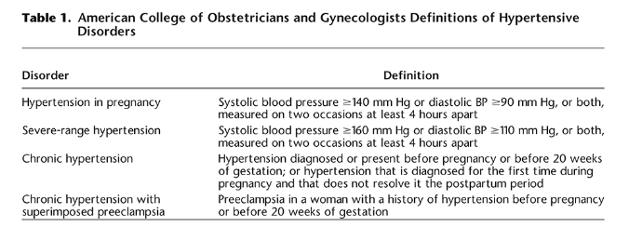
ACOG Definitions
ACOG PB 203; Jan 2019

Slide 8
CHTN in Pregnancy - MANAGEMENT
Baseline lab evaluation:
Complete blood count, Complete Metabolic Profile (electrolytes, LFTs, BUN/Cr)
Assessment for Proteinuria
Spot urine P:C ratio or 24-hour urine
P:C less than 0.15 safely indicates 24-hour urine less than 300 mg
Low Dose Aspirin (81 mg) should be initiated between 12 – 28 weeks (ideally prior to 16 weeks) for preeclampsia risk reduction
Electrocardiogram +/- echocardiogram for women with longstanding CHTN
Poorly controlled HTN (more than 4 years) or longstanding HTN more likely to have hypertrophic changes, cardiomegaly, and ischemic heart disease

Slide 9
CHTN in Pregnancy - MANAGEMENT
Discontinue ACE-inhibitors and Angiotensin Receptor Blockers
Risk of fetal/neonatal renal impairment, oligohydramnios, and renal failure
Possible increased risk of miscarriage, stillbirth, and congenital anomalies:
Oligohydramnios, anuria, renal failure/dialysis, hypotension, pulmonary hypoplasia, Respiratory Distress, fetal growth restriction, limb defects, hypocalvaria, fetal/perinatal death

Slide 10
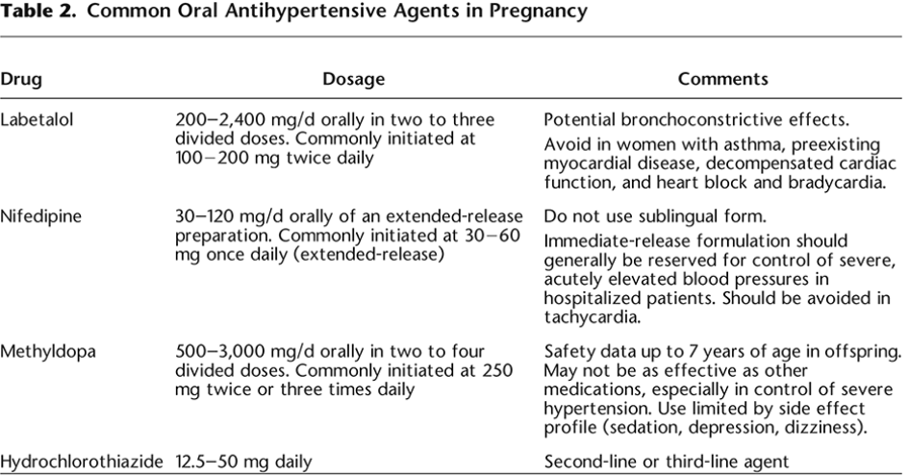
CHTN in Pregnancy - MANAGEMENT
ACOG PB 203; Jan 2019

Slide 11
CHTN in Pregnancy - MANAGEMENT
Use of Diuretics in Pregnancy
Thiazide diuretics – Not associated with fetal anomalies, but theoretical concern about interfering with pregnancy volume expansion
Would not initiate during pregnancy (without indication) but not unreasonable to continue if prescribed outside of pregnancy
Loop diuretics – Not routinely used in the antepartum setting. May be necessary in patients with significant cardiac dysfunction

Slide 12
CHTN in Pregnancy - MANAGEMENT
CHAP Trial
Published in NEJM in April 2022
Multicenter RCT
Pregnant women with mild chronic hypertension enrolled prior to 23 weeks randomized to early treatment vs no treatment until severe-range BP (SBP≥160, DBP ≥105)
Findings: reduced risk of preeclampsia with severe features, preterm birth < 35 weeks, placental abruption, fetal/neonatal death)
Birthweight less than 10%ile similar in both groups
Reference:

Slide 13
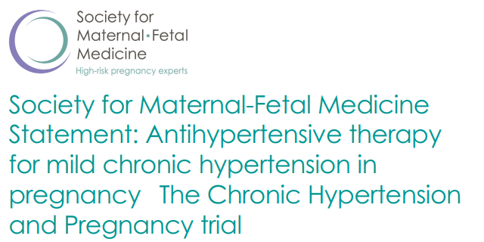
CHTN in Pregnancy - MANAGEMENT
CHAP Trial (2022)

Slide 14
CHTN with superimposed Preeclampsia
Preeclampsia is considered superimposed when it occurs in a patient with previously diagnosed chronic hypertension
Distinguishing superimposed PreE from 3rd trimester physiologic increase in BP (and proteinuria) is challenging
Sudden increase in previously well controlled BP
Need for rapid escalation of antihypertensive medications
New onset proteinuria
Sudden increase in proteinuria from previously known baseline
Presence of Severe Features
Severe persistent hypertension despite increasing therapy
Thrombocytopenia (platelet < 100,00/microliter)
Elevated transaminases (2x upper limit of normal)
Severe persistent RUQ/epigastric pain
New-onset or worsening renal function
Pulmonary Edema
Persistent visual or cerebral disturbances

Slide 15
CHTN with superimposed Preeclampsia
Suspected superimposed preeclampsia is best monitored initially in the inpatient setting
Assessment includes lab evaluation, proteinuria assessment, serial BP monitoring, fetal monitoring.
Initial assessment and disposition planning may take 24 – 48 hours
Outpatient management may be appropriate with no evidence of Severe features
Home BP monitoring, Weekly or twice weekly office visits, Weekly or twice weekly labs, fetal testing
Inpatient management for Preeclampsia with Severe Features

Slide 16
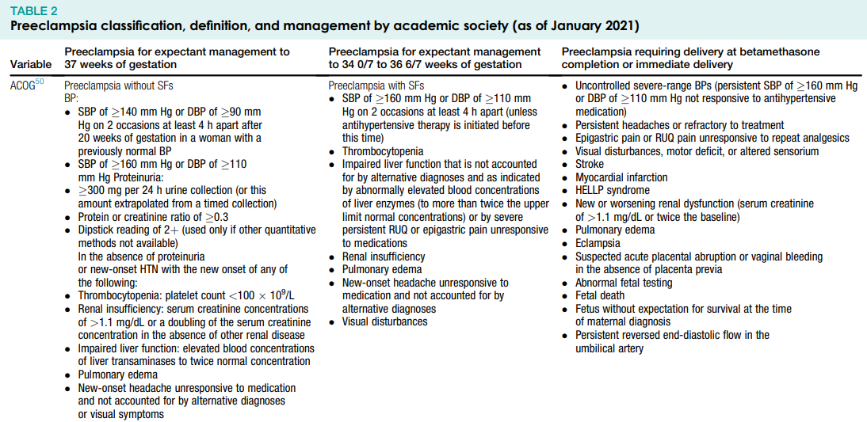
CHTN with superimposed Preeclampsia
SMFM SPECIAL REPORT| VOLUME 227, ISSUE 5, PB2-B24, NOVEMBER 2022

Slide 17
Chronic Hypertension with Superimposed PreEclampsia
Discussion

