Slide 1
WHAT IS HAPPENING WITH COVID IN PREGNANCY?
Donna D. Johnson

Slide 2
SOUTH CAROLINA
SC DHEC

Slide 3
COVID HOSPITALIZATIONS

Slide 4
COVID HOSPITALIZATIONS

Slide 5
COVID VACCINATION
NEJM, 2020

Slide 6
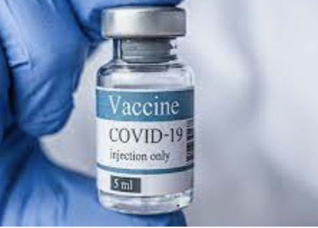
BEST PREVENTION OF COVID

Slide 7
PREGNANT WOMEN: VACCINATE
NEJM, 2021

Slide 8
PREGNANT WOMEN: VACCINATE
NEJM, 2021

Slide 9
COVID VACCINATION IN PREGNANCY
Does not need OB approval
Can be given in non-OB setting
OB counseling not required
Document recommendations
COVID can be co-administered with other vaccines
Women under 50 can get any vaccination
Thrombosis with thrombocytopenia syndrome (TTS)
ACOG, 2021

Slide 10
COVID SYMPTOMS
Fever or chills
Cough
Shortness of breath or difficulty breathing
Fatigue
Muscle or body aches
Headache
New loss of taste or smell
Sore throat
Congestion or runny nose
Nausea or vomiting
Diarrhea
TEST

Slide 11
EMERGENCY COVID SYMPTOMS
Trouble breathing
Persistent pain or pressure in the chest
New confusion
Inability to wake or stay awake
Go to ER or Call 911

Slide 12
TEST
Positive
Negative
Does not tell you the strain
Genotyping test

Slide 13
CLASSIFICATION OF COVID
Asymptomatic
Mild: sinusitis, sore throat, loss of smell or taste
Moderate: Cough, temperature, SOB with exertion, O2 sat > 94%*
Severe: Pneumonia, SOB with exertion, O2 sat < 94%*
Critical: Respiratory failure, sepsis, multiple organ failure
* > 95% in pregnancy

Slide 14
MONOCLONAL ANTIBODIES

Slide 15
CRITERIA

Slide 16
SIDE EFFECTS
Nausea, vomiting, diarrhea
Dizziness, headache, rash
Anaphylaxis

Slide 17
INFORMATION & CAVEATS
Infusion takes 1 hour
Observation for 1 hour
Used under emergency authorization
Can receive COVID vaccine for 90 days

