Slide 1
Medically Indicated Late Preterm and Early Term Delivery
Berry Campbell, MD
Project ECHO

Slide 2
When is term considered? Why?
In the past, the period from 3 weeks before until 2 weeks after the estimated date of delivery was considered “term,” with the expectation that neonatal outcomes from deliveries in this interval were uniform and good.
Increasingly, however, research has shown that neonatal outcomes, especially respiratory morbidity, vary depending on the timing of delivery within this 5-week gestational age range.

Slide 3
Eunice Kennedy Shriver NICHHD and
SMFM workshop, 2012
Created re-aligned definitions based on neonatal and maternal morbidity with delivery <39 weeks
Early term: 37-38 6/7 weeks
Full term: 39-40 6/7 weeks
Late term: 41-41 6/7 weeks
Post term: ≥ 42 weeks

Slide 4
Historically
37 week deliveries done for very weak indications
38 weeks considered same as ≥ 39 weeks by most obstetricians for convenience
Increased concern of respiratory morbidity → many amniocentesis for lung maturation studies
Awareness of other morbidities ie: neurodevelopmental, feeding, etc unrelated to lung maturation
BOTTOM LINE: Elective delivery only if ≥ 39 weeks GA; only INDICATED deliveries prior to 39 weeks

Slide 5
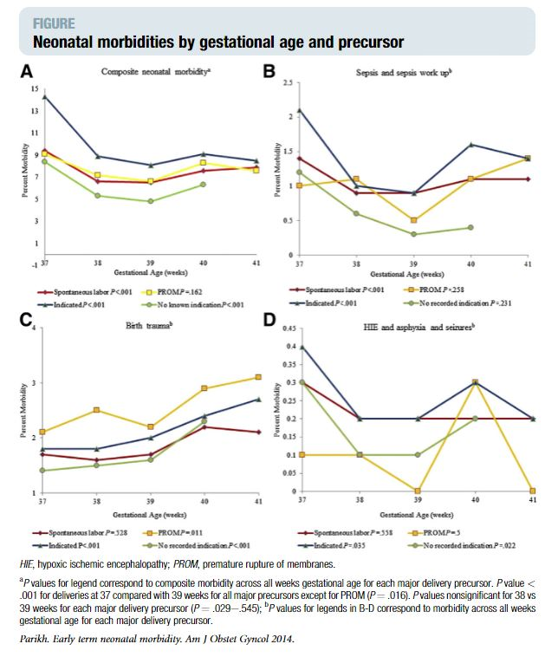

Slide 6
Medically indicated late preterm
(34-36 6/7 weeks)/ early term (37-38 6/7 weeks)
ACOG Committee Opinion #831, July 2021
Many maternal, fetal, placental complications warranting earlier delivery.
Balance benefits/risks
Workshop results plus most recent data—current recommendations.

Slide 7
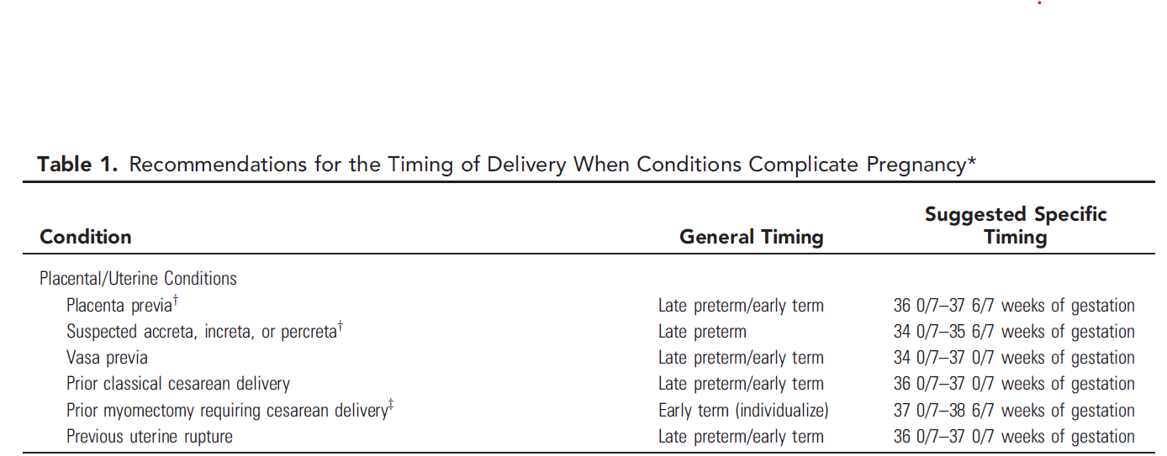
ACOG Committee Opinion 2021, Vol. 138, No. 1

Slide 8
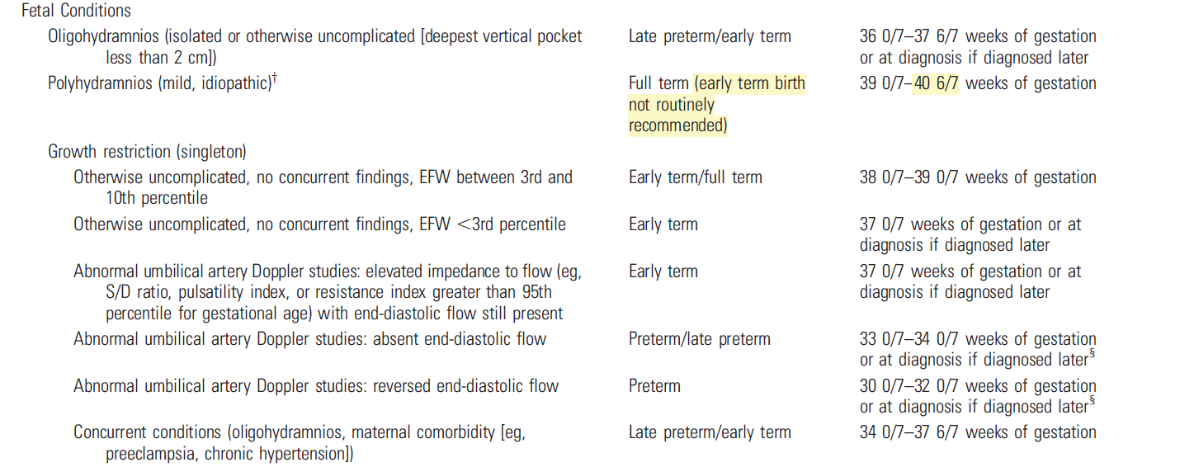
Recommendations for the Timing of Delivery When Conditions Complicate Pregnancy* (continued)
ACOG Committee Opinion 2021, Vol. 138, No. 1

Slide 9
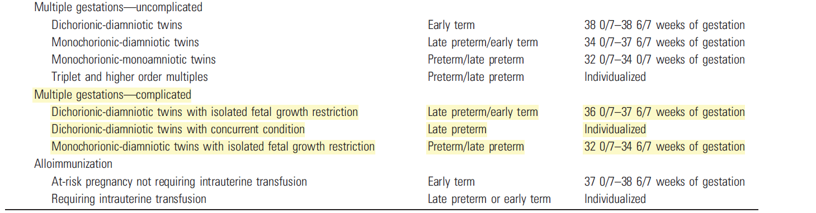
Recommendations for the Timing of Delivery When Conditions Complicate Pregnancy* (continued)
ACOG Committee Opinion 2021, Vol. 138, No. 1

Slide 10
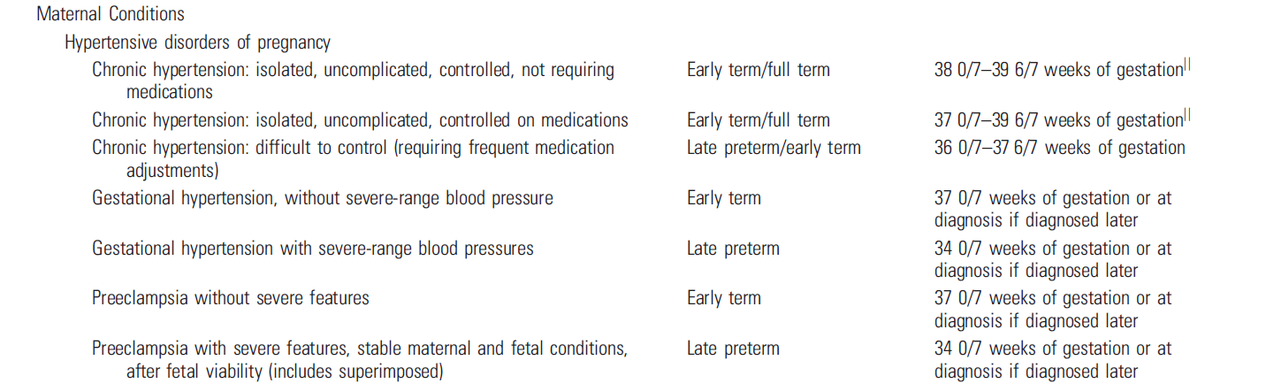
Recommendations for the Timing of Delivery When Conditions Complicate Pregnancy* (continued)
ACOG Committee Opinion 2021, Vol. 138, No. 1

Slide 11
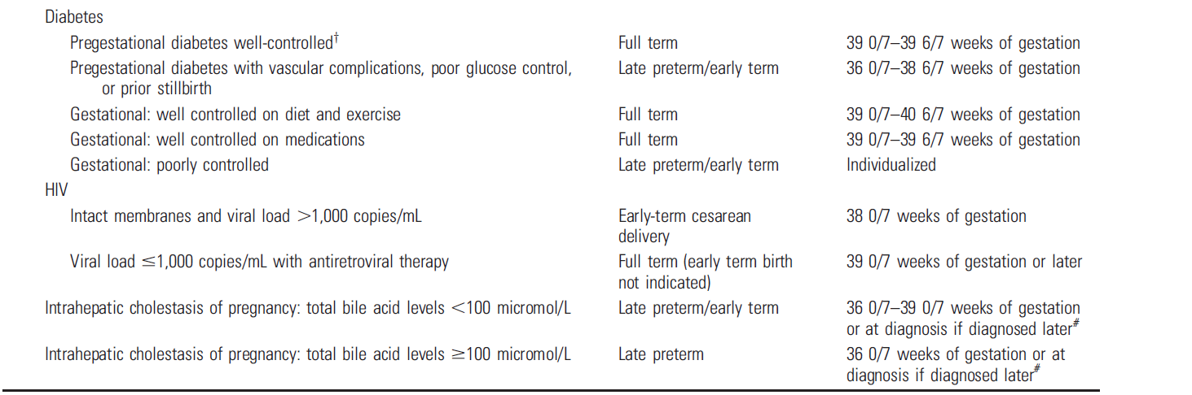
Recommendations for the Timing of Delivery When Conditions Complicate Pregnancy* (continued)
ACOG Committee Opinion 2021, Vol. 138, No. 1

Slide 12
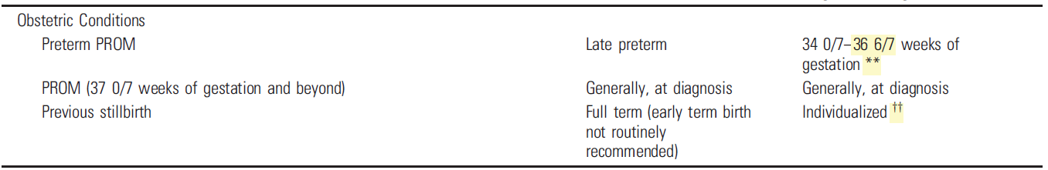
Recommendations for the Timing of Delivery When Conditions Complicate Pregnancy* (continued)
ACOG Committee Opinion 2021, Vol. 138, No. 1

Slide 13
Case 1
36 YO G4 P3003 with a known placenta previa.
Prior SVD x 3
Delivery timing?
She presents with her 3rd heavy bleeding episode at 35 weeks but has stopped—delivery? Wait?

Slide 14
Case 2
25 yo G3 P2002 diabetic admitted in second DKA of this pregnancy at 34 weeks
Limited PNC
A1C at 14 weeks was 8.2; A1C now 10.3.
When to deliver?

Slide 15
These recommendations for timing of delivery based on limited data (largely upon expert opinion) thus DECISIONS REGARDING TIMING FOR DELIVERY SHOULD BE INDIVIDUALIZED TO THE NEEDS OF THE PATIENT!

Slide 16
The list IS NOT ALL INCLUSIVE: compilation of commonly encountered indications in clinical practice.
Does not include all conditions: uterine dehiscence; chronic placental abruption; etc.
Individualized decisions based on best clinical judgement until more data available.

Slide 17
Project ECHO South Carolina Pregnancy Wellness
Visit Our Website: https://sctelehealth.org/services/pregnancy-wellness
From all of us at Project ECHO SC Pregnancy Wellness,
we are wishing you, your family, and friends a peaceful
New Year!

