Slide 1
SC Maternal Morbidity Mortality Review Committee
Data Analysis with Application to Clinical Practice
Project Echo November 1, 2023
Kimberly Jenkins, RN, BSN

Slide 2


Data Sources
2023 SC Maternal Mortality Review Committee Legislative Brief
CDC ERASE MM Initiative
DHEC Office Vital Statistics
South Carolina Behavioral Risk Factor Surveillance System (BRFSS)
Cross-sectional telephone survey
Representative of SC non-institutionalized adults (18+)
South Carolina Pregnancy Risk Assessment Monitoring System (PRAMS)
Cross-sectional, multimodal survey
Representative of SC women who gave birth in SC to a live infant
Addresses important topics before, during, and after pregnancy

Slide 3
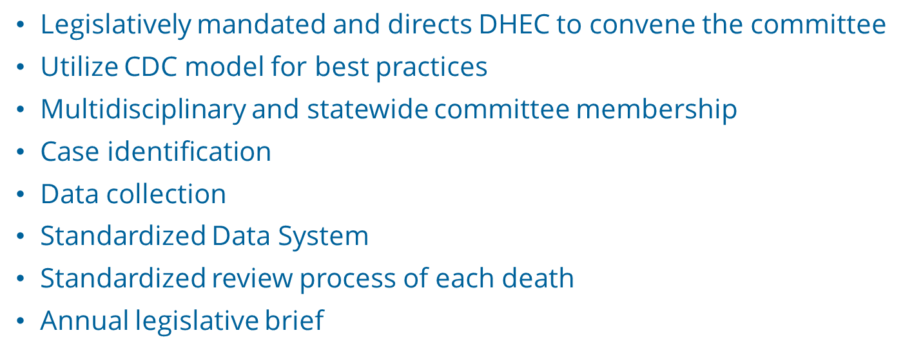
SC Maternal Mortality Review Committee (MMRC)

Slide 4
South Carolina MMMRC Scope, Mission, and Vision
SC Maternal Mortality Review Committee
Scope: To review all pregnancy-associated deaths of persons with indication of pregnancy up to 365 days, regardless of cause. | Mission: To identify pregnancy-associated deaths, review those caused by pregnancy complications and other associated causes and identify the factors contributing to these deaths and recommend public health and clinical interventions that may reduce these deaths and improve systems of care. | Vision: The Maternal Mortality Review Committee’s vision is to eliminate preventable maternal deaths, reduce maternal morbidities, and improve population health for those of reproductive age.
Sourced from: MMRIA Facilitation Guide https://reviewtoaction.org/content/committee-facilitation-guide

Slide 5
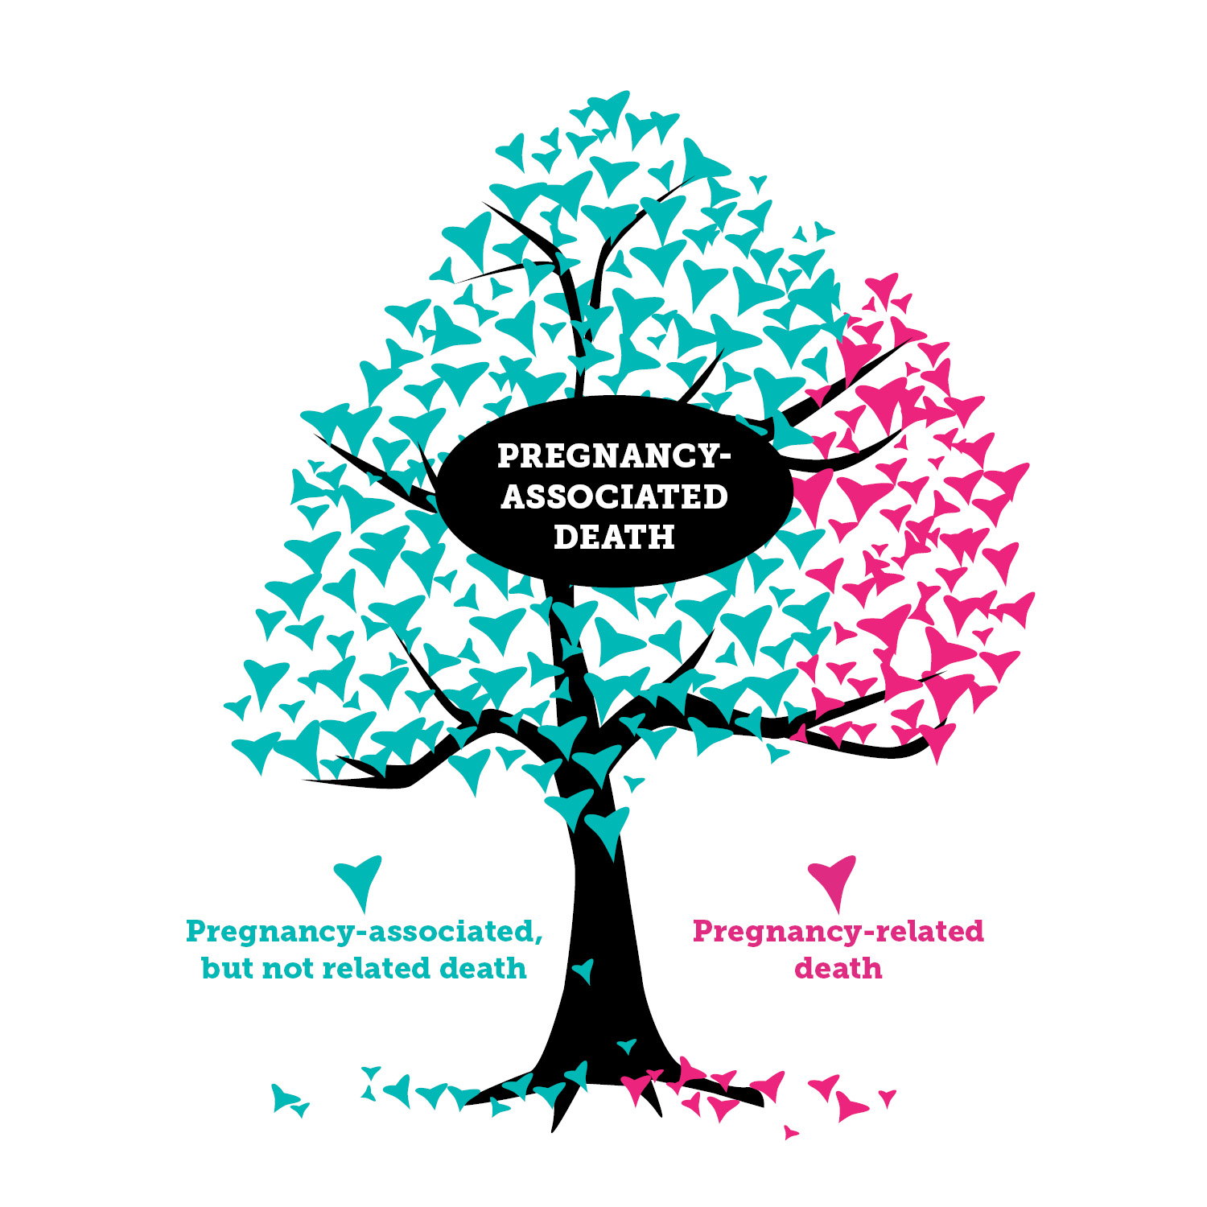

Key Definitions
  Pregnancy-associated death:
    A death during or within one year of pregnancy irrespective of cause.
Pregnancy-related death:
  A death while pregnant or within one year of the end of pregnancy from a pregnancy complication, a chain of events initiated by pregnancy, or the aggravation of an unrelated condition by the physiologic effects of pregnancy.
Pregnancy-associated but NOT related death:
  A death during or within one year of the end of pregnancy from a cause that is not related to pregnancy.
Sourced from: MMRIA Facilitation Guide and Review to Action https://reviewtoaction.org/content/mmria-committee-facilitation-guide
Graphic sourced from: South Dakota Department of Health https://doh.sd.gov/statistics/maternalmortality.aspx
Notes:
Key Definitions:
-For pregnancy-related death, it is important to remember “if she had not been pregnant would she have died?”

Slide 6
Every Maternal Death is a Tragedy
42
In 2018-2019, 42 women died because of pregnancy complications, the committee reviewed 115 pregnancy associated deaths.
Sourced from: 2022 and 2023 SCMMMRC Legislative Briefs
Notes:
Possible script for slide:

Slide 7
Pregnancy Related Mortality Ratio (PRMR)
PRMR, by Year
Rate
In 2019 there were 22 Pregnancy Related deaths among 57,044 live births, resulting in a PRMR of 38.6 per 100k live births, a 9.3% increase from 2018. The United States PRMR is 17.6
Note: Rate per 100,000 live births

Slide 8
Racial Disparities
PRMR, by Race
Rate
Black mothers experienced a 67% higher PRMR than their White counterparts.
Note: 2018-2019; Rate per 100,000 live births; non-Hispanic
Notes:
More breakouts once data becomes available.

Slide 9
Leading Causes of PR Deaths
The leading causes of PR Deaths differ by races. Mental Health Conditions were the leading cause of death among Non-Hispanic White women while Cardiomyopathy was the leading cause among non-Hispanic Black women.
PR Deaths, by Cause of Death
Percent
Note: 2018-2019

Slide 10
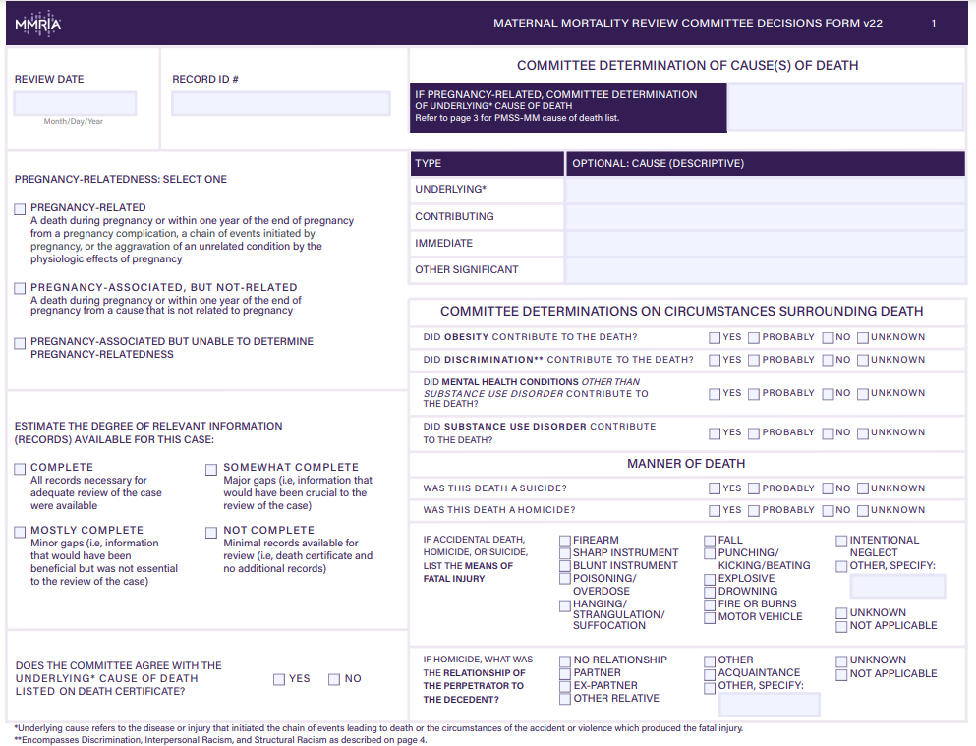
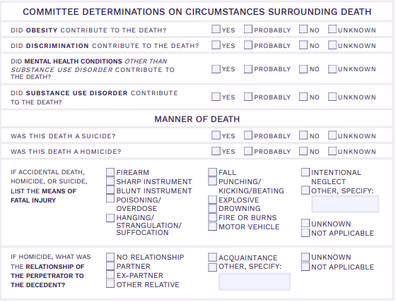
Review:
Committee Determinations on Circumstances Surrounding Death
Complete section for all pregnancy-associated deaths reviewed by your committee, regardless of relatedness.

Slide 11
Circumstances
Discrimination is described as treating someone less or more favorably based on the group, class or category they belong to resulting from biases, prejudices, and stereotyping. It can manifest as differences in care, clinical communication, and shared decision-making.
Circumstances Surrounding PR Deaths
Percent
Note: 2018-2019

Slide 12
Obesity is a key risk factor associated with maternal deaths
  A recent study found the risk of maternal death among obese women is more than tripled that of normal weight women (Saucedo et al 2021)
  Obesity during pregnancy can lead to other complications
In South Carolina, 38% of women 18-44 reported having obesity
  This is highest among non-Hispanic Black women
Saucedo M, Esteves-Pereira AP, Pencolé L, Rigouzzo A, Proust A, Bouvier-Colle MH; CNEMM study group; Deneux-Tharaux C. Understanding maternal mortality in women with obesity and the role of care they receive: a national case-control study. Int J Obes (Lond). 2021 Jan;45(1):258-265. doi: 10.1038/s41366-020-00691-4. Epub 2020 Oct 22. PMID: 33093597; PMCID: PMC7752756.

Slide 13
Recommendation/Clinical Application
All birthing women should have an established primary care provider who can address chronic health, mental health conditions before, during and after pregnancy.

Slide 14
Mental health conditions were the second leading cause of pregnancy-related deaths in SC in 2018-2019
  In SC, 29% of women 18-44 reported having depression, and this was highest among non-Hispanic White women (37.2%)
  Additionally, 24% of women 18-44 reported 14 or more days their mental health was not good in the last month, and this was also highest among non-Hispanic White women (27%)
https://www.cdc.gov/reproductivehealth/maternal-mortality/erase-mm/data-mmrc.html

Slide 15
Substance use disorder has been linked with serious adverse pregnancy outcomes, including maternal mortality
In South Carolina, 10% of women 18-44 reported ever having a problem with drugs or alcohol
  This was most prevalent among non-Hispanic White women
Additionally, 6.5% of new moms reported prescription opioid use during pregnancy (SC PRAMS 2019-2020)

Slide 16
Recommendation/Clinical Application
All birthing women should have Screening, Brief Intervention, Referrals and Treatment (SBIRT) screenings for mental health and be screened for substance use, domestic violence, and chronic disease at the initial prenatal appointment, during pregnancy and at post-partum follow up appointments.
All birthing women should have an established primary care provider who can address chronic health, mental health conditions before, during and after pregnancy.

Slide 17
Review: Committee Determination on Discrimination
This checkbox refers to discrimination. Discrimination is treating someone less or more favorably based on the group, class or category they belong to resulting from biases, prejudices, and stereotyping. It can manifest as differences in care, clinical communication and shared decision-making. (Smedley et al, 2003 and Dr. Rachel Hardeman)
Notes:
1. Should the checkboxes be completed for all pregnancy-associated deaths or just those determined to be pregnancy-related?
The checkboxes should be completed for all pregnancy-associated deaths reviewed by your committee, regardless of relatedness. If your committee does not review a woman’s death because it is considered out of your scope, there is no need to complete the checkboxes.
2. Should the checkboxes be completed in reference to the woman, or the broader context surrounding her death?
The checkboxes refer to the woman’s own experience. For example, if a woman had a substance use disorder (see definition on page 4 of the MMRIA Committee Decisions Form) which contributed to her death, the checkbox should be marked ‘yes’. In contrast, if the death was a homicide where the perpetrator had a substance use disorder, but the woman did not, the checkbox should be marked ‘no’.
3. If substance use was involved in the death, should we choose ‘yes’ for the substance use disorder checkbox?
This checkbox refers to ‘substance use disorder’, not just substance use. The committee should only choose ‘yes’ or ‘probably’ if there is indication of a substance use disorder diagnosis or an expert on the committee (e.g. psychiatrist, psychologist, licensed counselor) who feels that the criteria for a diagnosis of substance use disorder are met based on the available information. In addition, the committee needs to decide that the substance use disorder was a contributing factor in the death.
4. Did discrimination contribute to the death?
Discrimination is treating someone less or more favorably based on the group, class or category they belong to resulting from biases, prejudices, and stereotyping. It can manifest as differences in care, clinical communication and shared decision-making.
5. For the substance use disorder and mental health conditions checkboxes, is a formal diagnosis required?
A diagnosis should ideally be indicated in the woman’s medical records. However, this may underestimate the number of women with substance use disorder or mental health conditions if women are unable to access care or treatment. Refer to your review committee subject matter experts (e.g. psychiatrist, psychologist, licensed counselor) to determine whether the criteria for a diagnosis of substance use disorder or another mental health condition are met based on the available information.
6. If substance use disorder contributed to the death, but another mental health condition did not, should we also choose ‘yes’ for the mental health conditions checkbox?
No, substance use disorder should be captured separately from other mental health conditions.
7. If certain deaths are not reviewed by our committee (for example, suicides and homicides), should we still complete the checkboxes?
No, these checkboxes are intended to the capture the committee decisions. If a death is not reviewed by the committee, the checkboxes should not be completed.
8. What if our determination for manner of death does not match the manner indicated on the death record?
The checkboxes are intended to capture the decisions of the review committee, and it is expected that sometimes these decisions may differ from the death record. For example, an overdose may have an unknown manner of death on the death certificate, but relevant subject matter experts (e.g. medical examiner), could review additional information and determine that the overdose was intentional. The committee would then check ‘yes’ for the suicide checkbox. There is also a question on the committee decisions form to indicate whether the committee agrees with the cause of death listed on the death certificate.
9. Are there opportunities for quality improvement with the checkbox data?
Yes, there are lots of opportunities using checkbox data. For example, all overdoses with indication of substance use disorder should have an underlying cause of death PMSS code of 100, 100.1, or 100.9 (Mental Health Conditions). If the substance use disorder checkbox is checked ‘yes’, but the PMSS code is 88.2 (Unintentional Injury), there may be discrepancies in how the PMSS code is being selected.
Another opportunity for quality improvement is to compare the obesity checkbox with the women’s actual BMI calculated using the height and weight provided in her records. Are there instances where your committee is selecting ‘yes’ when the BMI suggests she is at a healthy weight? Of note—this checkbox is intended to capture whether obesity contributed to the death, not whether the woman was obese / obesity was present.

Slide 18
Discrimination is also an important risk factor affecting maternal health outcomes of women of color
  Bias experienced during health care services contributes to racial disparities in maternal mortality
In South Carolina, 5% of women 18-44 reported they felt treated worse than others races when seeking health care
  This was more than doubled among non-Hispanic Black women
https://www.nhlbi.nih.gov/news/2021/systemic-racism-key-risk-factor-maternal-death-and-illness

Slide 19

PHRASING THAT CAN INDICATE DISCRIMINATION
“Drug-seeking”
“Non-compliant”
Related to physical appearance
  Weight
  Tattoos or piercing
  Race or ethnicity
Related to pay source for care
Related to age
Credit: Connie Graves (TN MMRC)

Slide 20
DISCRIMINATION & RACISM
Discrimination
Treating someone less or more favorably based on the group, class or category they belong to resulting from biases, prejudices, and stereotyping. It can manifest as differences in care, clinical communication, and shared decision-making.
Interpersonal Racism
Discriminatory interaction between individuals based on differential assumptions about the abilities, motives, and intentions of others and resulting in differential actions toward others based on their race. It can be conscious as well as unconscious, and it includes acts of commission and acts of omission. It manifests as lack of respect, suspicion, devaluation, scapegoating, and dehumanization.
Structural Racism
Systems of power based on historical injustices and contemporary social factors that systematically disadvantage people of color and advantage white people through inequities in housing, education, employment, earnings, benefits, credit, media, health care, criminal justice, etc.
Hardeman RR, Kheyfets A, Mantha AB, et al. Developing Tools to Report Racism in Maternal Health for the CDC Maternal Mortality Review Information Application (MMRIA): Findings from the MMRIA Racism & Discrimination Working Group. Matern Child Health J. 2022 Apr;26(4):661-669

Slide 21
IDENTIFYING – INTERPERSONAL RACISM
Hypothetical examples developed based on case review observation
Low expectations of patient engagement and failed shared-decision making
e.g., Providers notes show decisions made without consultation or shared decision-making tools;
family interview reports that decedent was frustrated and felt the provider was not listening.
Ignored or improperly treated symptoms and pain, delays in treatment
e.g., Decedent spends 14 hours in triage and does not receive the standard of care, notes
throughout the medical record indicate providers did not take action based on the patient’s acute
condition and reported levels of pain.
Explicit bias in interactions with service providers (health care or other) which directly delay
emergency care
e.g., As patient was en route to the hospital during emergency event, family tries to flag down a police officer for help, but officer’s initial response was to order Black, male family members to the ground while their hand is on a taser.
Source: CDC ERASE MM

Slide 22
IDENTIFYING DISCRIMINATION –STRUCTURAL RACISM
Hypothetical examples developed based on case review observation
Inadequate staffing in hospitals – or inadequate hospitals – in specific geographies
e.g., Lack of providers accepting patients insured by Medicaid for perinatal care in geographies where majority of Black birthing people have Medicaid during pregnancy.
Transport delays limiting access to care
e.g., Decedent delayed seeking care postpartum due to limited transport options to provider.
Lack of availability of translation services throughout perinatal or emergency care
e.g., Full medical history is not known because translation services were not available.
Source: CDC ERASE MM

Slide 23
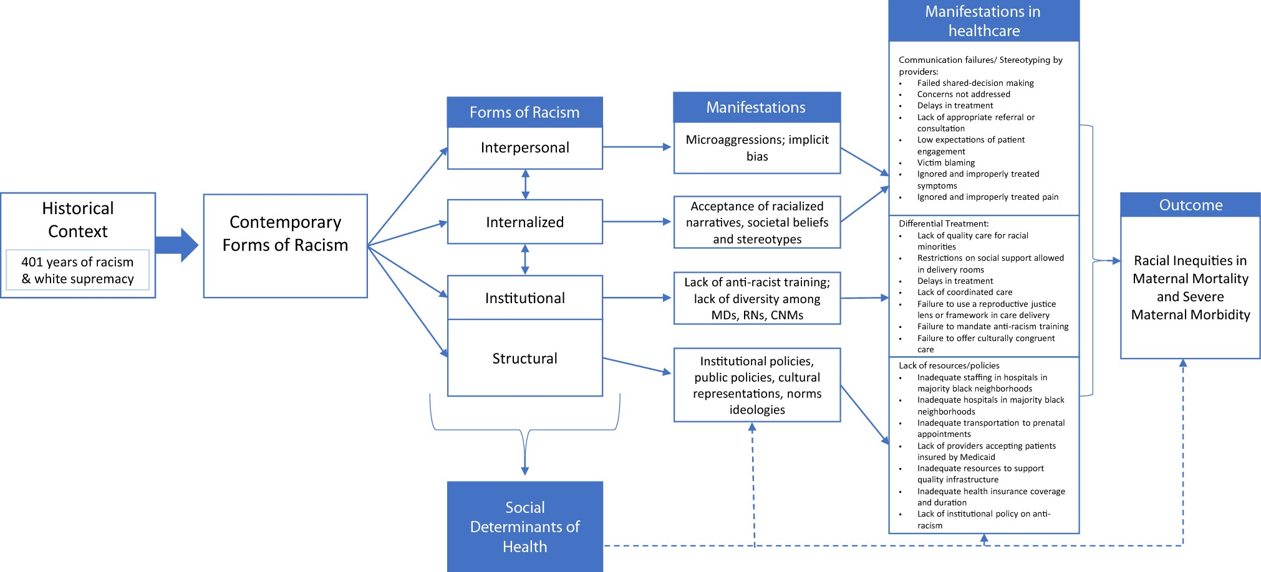
Fig 1. A Conceptual Model of how Racism Operates and Results in Inequities in Maternal Mortality and Severe Maternal Morbidity
Hardeman RR, Kheyfets A, Mantha AB, et al. Developing Tools to Report Racism in Maternal Health for the CDC Maternal Mortality Review Information Application (MMRIA): Findings from the MMRIA Racism & Discrimination Working Group. Matern Child Health J. 2022 Apr;26(4):661-669

Slide 24
Recommendation/Clinical Application
Recognize and address racism and improve the quality of care to birthing women of color. Birthing women of color should receive equitable and comprehensive care during pregnancy and the post-partum period.
All SC hospitals and obstetric providers should utilize interpretative services to assist birthing women when English is not their primary language.

Slide 25
Geography
PRMR, by Rurality
Rate
Mothers in rural counties experienced PR deaths at a 70.4% higher rate than mothers in urban counties.
Note: 2018-2019; Rate per 100,000 live births.

Slide 26

Over 70% of the PR deaths occur in the postpartum period
Recommendation: All birthing women should have a post-partum appointment within 1-3 weeks following delivery.

Slide 27
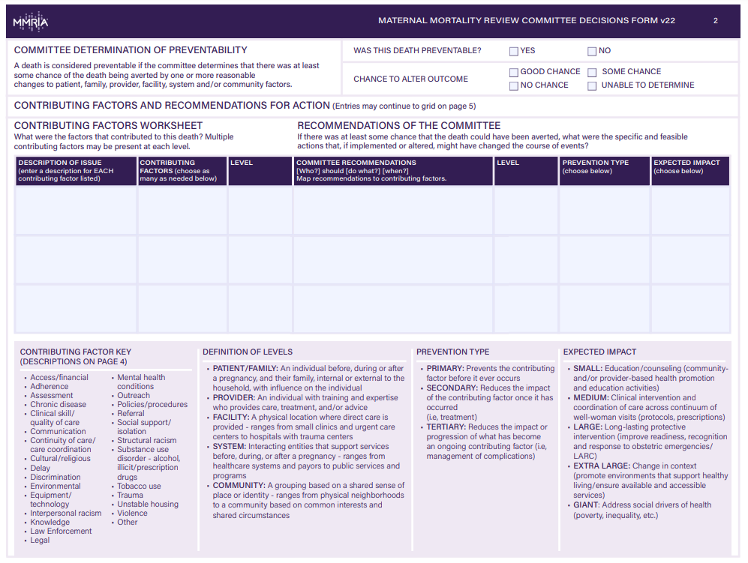
Preventability
Preventability
A death is considered preventable if the committee determines that there was at least some chance of the death being averted by one or more reasonable changes to patient, family, provider, facility, system and/or community factors.
Prevention occurs at various levels, patient and family, provider, facility, system and community
Notes:
Why determine preventability?
Preventability provides a framework of prioritization for recommendations.
Why do preventability estimates vary between MMRCs?
Preventability determinations are often a reflection of MMRC composition. Multidisciplinary MMRCs have a greater understanding of opportunities to prevent deaths.
What should our committee do if we get stuck on the preventability question?
It may be helpful to first discuss the factors that contributed to the death, and recommendations to address those contributing factors.
How can we avoid speculation in the case of inadequate or incomplete case information?
Inadequate information can make any case determination difficult. It’s important not to resort to speculation, stay on task, admit that you don’t know what you don’t know about the case and the Chair may direct the committee to move on.
How can we help the media and the public broaden the focus on preventability, particularly beyond the provider/facility level?
Addressing medical factors alone will not get us to the reductions we want to achieve. In order to broaden this perspective committees must document factors and recommendations at all levels (Patient/Family, Provider, Facility, System and Community). Multidisciplinary review promotes understanding of patient-, community-, and system-level factors as well as development of actionable recommendation at all levels.
How can we craft recommendations that are useful to abstractors, analysts and for reporting to stakeholders and the public?
An actionable recommendation is mapped to a contributing factor and is structured as follows: [Who] should [do what], [when/where?] A diversity of voices at the table provide greater perspective on system-level factors that may influence factors such as late entry into prenatal care

Slide 28
Prevention
Preventability of PR Deaths
Percent
More than 4 out of every 5 PR deaths were preventable.

Slide 29
Contributing Factors of PR Deaths
Access/financial
Adherence
Assessment
Chronic disease
Clinical skill
Poor communications
Continuity of care
Cultural/religious
Delay
Discrimination
Environmental
Interpersonal racism
Knowledge
Law enforcement
Legal
Mental health conditions
Outreach resources
Policies/procedures
Referral
Support support/isolation
Structural racism
Substance use disorder
Tobacco use
Trauma
Unstable housing
Violence and IPV
Other

Slide 30
Strategies for Preventing Pregnancy-Related Deaths
Step 1: Use data to understand the scope of the problem.
Step 2: Understand the context of the solution.
Step 3: Identify potential goals and strategies.
Step 4: Act on your strategies.
Sourced from: https://www.Cdc.gov/reproductivehealth/maternal-mortaliyt/preventing-pregnancy-related-death/state-strategies.html

Slide 31
Moving the Needle to Prevent Maternal Mortality in South Carolina
SC Birth Outcomes Initiative (BOI)
Alliance for Innovation on Maternal Health (AIM) and safety bundles
Extended Medicaid Coverage to 12 months postpartum
SC's Perinatal Regionalized System of Care
Educate providers and hospital staff
Partner with stakeholders
Increase funding for maternal health
Collaborate with community partners
Promote the CDC Hear Her Campaign

Slide 32
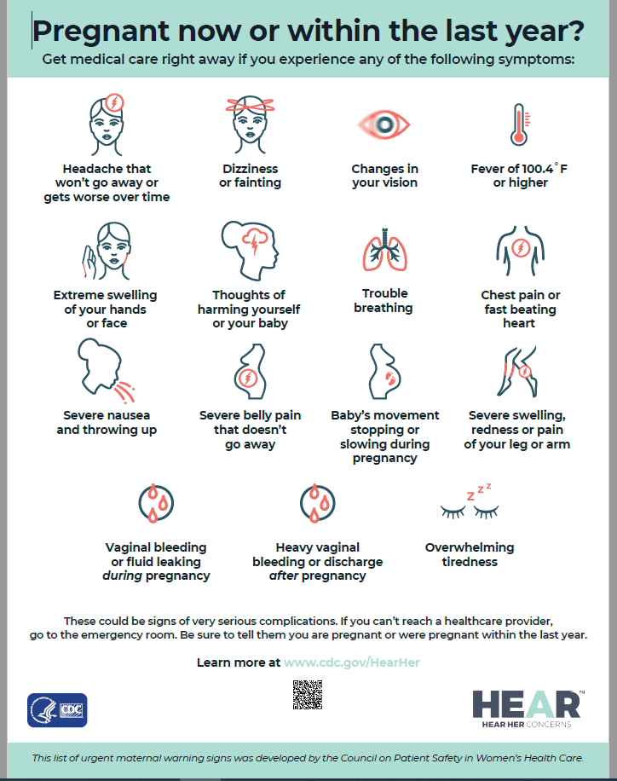

Slide 33
Thank you
Comments or Questions?
Kimberly Jenkins jenkinka@dhec.sc.gov

