Slide 1
Subutex, Suboxone, or Methadone: Which is better for baby?
Lisa Boyars
Medical University of South Carolina

Slide 2
Neonatal Abstinence Syndrome (NAS) or Neonatal Opioid Withdrawal Syndrome (NOWS)
Refers to an opioid withdrawal syndrome characterized by behavioral dysregulation that occurs within 2-3 days of birth for infants exposed chronically to opioids in-utero. Signs and symptoms include altered sleep, high muscle tone, tremors, irritability, poor feeding, vomiting and diarrhea, sweating, tachypnea, fevers, and other autonomic nervous system disturbances. All opioids can cause withdrawal symptoms, including methadone, buprenorphine (Subutex, Suboxone), and short-acting agents such as oxycodone, heroin, and fentanyl, but the severity of these symptoms vary greatly.

Slide 3
NAS statistics
**Methadone or buprenorphine dose is not consistently related to NAS/NOWS severity

Slide 4
Other factors contributing to NAS
Genetics
Other substances
Tobacco use
Benzodiazepines
SSRIs
Birth weight & weeks gestational age
Hospital protocols
NAS assessment choice
Not breastfeeding
Separating mother and baby
Rooming in/ skin to skin contact

Slide 5
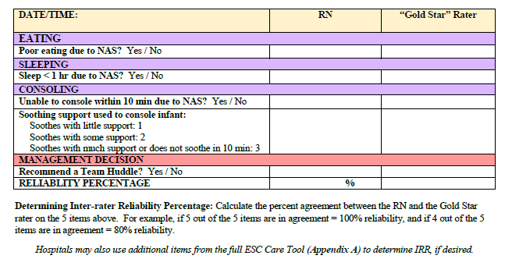
Eat, sleep, console
This approach focuses on the comfort and care of infants by maximizing nonpharmacologic methods, increasing family involvement in the treatment of their infant, and prn or "as needed" use of morphine.

Slide 6
Medication Options
Methadone
Buprenorphine monotherapy
Buprenorphine + naloxone

Slide 7
Methadone vs Buprenorphine Advantages
 | Methadone | Buprenorphine
Advantages
Reduces cravings
Blocks effects of other opioids
Prevents onset of withdrawal for 24 hours
Lower risk of overdose
Fewer drug interactions
Shorter NAS course

Slide 8
Methadone vs Buprenorphine Disadvantages
Methadone:
Achieving stable dose
Increased risk of overdose
Often requires daily visits to federally qualified programs
Longer NAS duration and more medication to treat NAS
Buprenorphine:
Can precipitate clinical withdrawal
Possible increased risk of diversion

Slide 9
MOTHER Study: Buprenorphine vs Methadone
Compared with methadone-exposed neonates, buprenorphine-exposed neonates
Both medications in the context of comprehensive care produced similar maternal treatment and delivery outcomes
Neonates exposed to Buprenorphine…
Required 89% less morphine to treat NAS
Spent 43% less time in the hospital
Spent 58% less time in the hospital being medicated for NAS
Jones HE, Kaltenbach K, Heil SH, et al. N Engl J Med. 2010

Slide 10
Meta-Analysis: Buprenorphine vs Methadone
Buprenorphine-exposed neonates had:
Higher mean gestational age
Greater weight
Greater length
Greater head circumference at birth.
In treated neonates, NAS treatment duration was shorter and total morphine dose was lower
Brogly SB et al. Am J Epidemiol 2014.

Slide 11
Buprenorphine+ Naloxone vs. Buprenorphine or Methadone
Collective data comparing buprenorphine+naloxone to methadone show:
Similar maternal outcomes as those seen with buprenorphine alone
Similar reductions in NAS severity
Collective data comparing buprenorphine+naloxone to buprenorphine alone show:
Similar maternal outcomes
Similar birth outcomes including NAS severity
Lund IO, et al. Subst Abuse. 2013
Wiegand SL, et al., Obstet Gynecol. 2015;125(2):363-368.

Slide 12
Breastfeeding
Breastfeeding is recommended for women on buprenorphine and methadone.
There are no data on the combination product buprenorphine/naloxone in breastfeeding, however oral absorption of naloxone is minimal.
Advise the nursing mother taking buprenorphine+naloxone to monitor the infant for increased drowsiness and breathing difficulties.

